Slide 1

Lecture 6: Bayesian Inference of Phylogeny and MCMC Diagnosis
Brian R. Moore Department of Evolution & Ecology University of California, Davis
CoME, 2019

Slide 2
Outline
I. Bayesian inference, redux
The anatomy and meaning of Bayes theorem

Slide 3
Outline
I. Bayesian inference, redux
The anatomy and meaning of Bayes theorem
II. Numerical algorithms for Bayesian inference
Markov-chain Monte Carlo (MCMC)
Metropolis-Hastings algorithm
Metropolis-Coupled algorithm
Summarizing posterior samples

Slide 4
Outline
I. Bayesian inference, redux
The anatomy and meaning of Bayes theorem
II. Numerical algorithms for Bayesian inference
Markov-chain Monte Carlo (MCMC)
Metropolis-Hastings algorithm
Metropolis-Coupled algorithm
Summarizing posterior samples
III. Diagnosing MCMC performance
Motivation and overview of the basics

Slide 5
Outline
I. Bayesian inference, redux
The anatomy and meaning of Bayes theorem
II. Numerical algorithms for Bayesian inference
Markov-chain Monte Carlo (MCMC)
Metropolis-Hastings algorithm
Metropolis-Coupled algorithm
Summarizing posterior samples
III. Diagnosing MCMC performance
Motivation and overview of the basics
IV. MCMC Diagnostics
General strategies:
diagnostics based on single chains
diagnostics based on the prior
diagnostics based on multiple, replicate chains

Slide 6
Outline
I. Bayesian inference, redux
The anatomy and meaning of Bayes theorem
II. Numerical algorithms for Bayesian inference
Markov-chain Monte Carlo (MCMC)
Metropolis-Hastings algorithm
Metropolis-Coupled algorithm
Summarizing posterior samples
III. Diagnosing MCMC performance
Motivation and overview of the basics
IV. MCMC Diagnostics
General strategies:
diagnostics based on single chains
diagnostics based on the prior
diagnostics based on multiple, replicate chains

Slide 7
Bayesian Inference
Bayes Theorem
The posterior probability of observing A given that B has occurred, Pr(A⏐B), is proportional to the product of the conditional probability of Pr(A⏐B) and the unconditional probability of A, Pr(A).
Pr(A⏐B)
=
Pr(B⏐A)
Pr(A)
Pr(B)

Slide 8
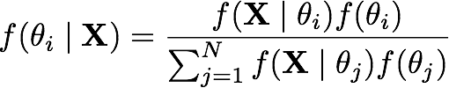
Bayesian Inference
Bayes Theorem
The posterior probability of observing A given that B has occurred, Pr(A⏐B), is proportional to the product of the conditional probability of Pr(A⏐B) and the unconditional probability of A, Pr(A).
Pr(A⏐B)
=
Pr(B⏐A)
Pr(A)
Pr(B)
unobserved outcome
observed outcome

Slide 9
Bayesian Inference
Bayes Theorem
The posterior probability of observing A given that B has occurred, Pr(A⏐B), is proportional to the product of the conditional probability of Pr(A⏐B) and the unconditional probability of A, Pr(A).
Pr(A⏐B)
=
Pr(B⏐A)
Pr(A)
Pr(B)
posterior probability
likelihood function
prior probability
marginal likelihood

Slide 10
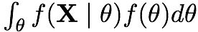
Bayesian Inference
Bayes Theorem
The posterior probability of observing A given that B has occurred, Pr(A⏐B), is proportional to the product of the conditional probability of Pr(A⏐B) and the unconditional probability of A, Pr(A).
Pr(A⏐B)
=
Pr(B⏐A)
Pr(A)
Pr(B)
posterior probability
likelihood function
prior probability
marginal likelihood

Slide 11
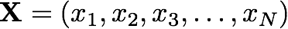
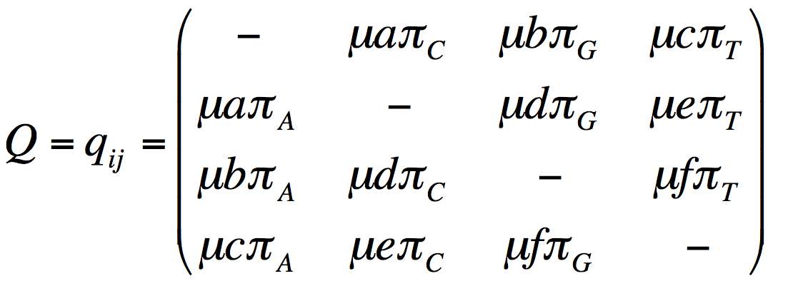
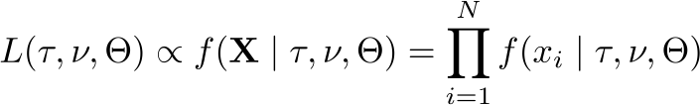
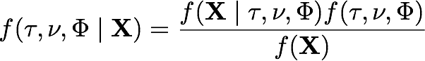
Bayesian Inference of Phylogeny (on one slide)
posterior probability
likelihood function
prior probability
I. Data
marginal likelihood
Assume an alignment, X, of N sites for S species:
II. Phylogenetic model parameters
IV. Priors on parameters
1. Tree
topology
~Uniform
branch lengths
~Dirichlet (1,...,1)
2. Model of character change
A
G
relative substitution rates
~Dirichlet (1,1,1,1,1,1)
stationary frequencies
~Dirichlet (1,1,1,1)
C
T
III. Phylogenetic likelihood function
V. Posterior Probability
prior probability

Slide 12
Bayesian Inference of Phylogeny (on one slide)
I. Data
Assume an alignment, X, of N sites for S species:
II. Phylogenetic model parameters
IV. Priors on parameters
1. Tree
topology
~Uniform
branch lengths
~Dirichlet (1,...,1)
2. Model of character change
relative substitution rates
~Dirichlet (1,1,1,1,1,1)
stationary frequencies
~Dirichlet (1,1,1,1)
III. Phylogenetic likelihood function
V. Posterior Probability

Slide 13
Outline
I. Bayesian inference, redux
The anatomy and meaning of Bayes theorem
II. Numerical algorithms for Bayesian inference
Markov-chain Monte Carlo (MCMC)
Metropolis-Hastings algorithm
Metropolis-Coupled algorithm
Summarizing posterior samples
III. Diagnosing MCMC performance
Motivation and overview of the basics
IV. MCMC Diagnostics
General strategies:
diagnostics based on single chains
diagnostics based on the prior
diagnostics based on multiple, replicate chains

Slide 14
Outline
I. Bayesian inference, redux
The anatomy and meaning of Bayes theorem
II. Numerical algorithms for Bayesian inference
Markov-chain Monte Carlo (MCMC)
Metropolis-Hastings algorithm
Metropolis-Coupled algorithm
Summarizing posterior samples
III. Diagnosing MCMC performance
Motivation and overview of the basics
IV. MCMC Diagnostics
General strategies:
diagnostics based on single chains
diagnostics based on the prior
diagnostics based on multiple, replicate chains

Slide 15
Bayesian Inference of Phylogeny (on one slide)
I. Data
Assume an alignment, X, of N sites for S species:
II. Phylogenetic model parameters
IV. Priors on parameters
1. Tree
topology
~Uniform
branch lengths
~Dirichlet (1,...,1)
2. Model of character change
relative substitution rates
~Dirichlet (1,1,1,1,1,1)
stationary frequencies
~Dirichlet (1,1,1,1)
III. Phylogenetic likelihood function
V. Posterior Probability
marginal likelihood
prior probability

Slide 16
Bayesian Inference of Phylogeny (on one slide)
posterior probability
likelihood function
prior probability
I. Data
marginal likelihood
Assume an alignment, X, of N sites for S species:
II. Phylogenetic model parameters
IV. Priors on parameters
1. Tree
topology
~Uniform
branch lengths
~Dirichlet (1,...,1)
2. Model of character change
A
G
relative substitution rates
~Dirichlet (1,1,1,1,1,1)
stationary frequencies
~Dirichlet (1,1,1,1)
C
T
III. Phylogenetic likelihood function
V. Posterior Probability

Slide 17
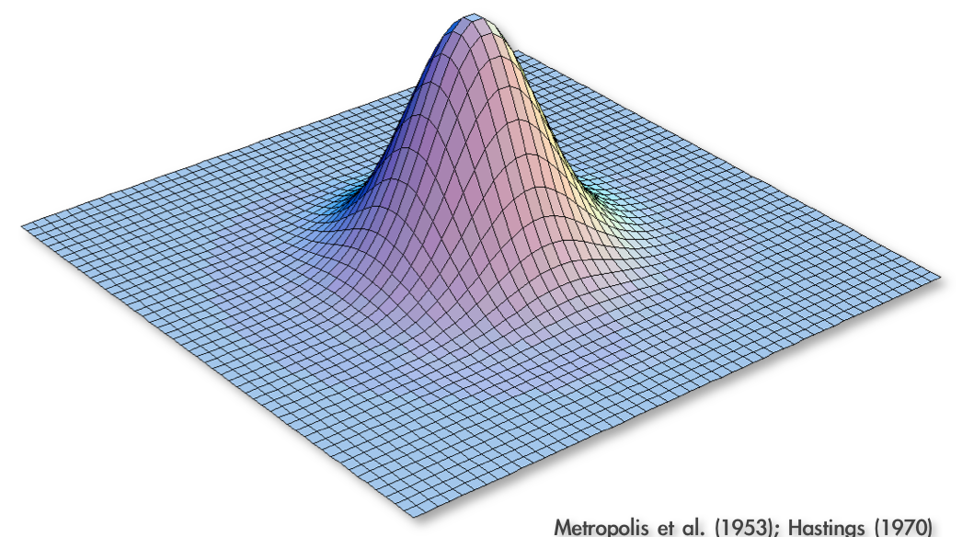
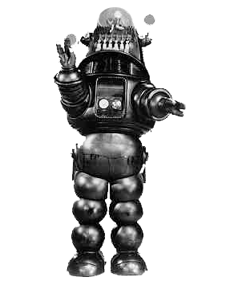
Approximating the Joint Posterior Probability Density using MCMC
Programming our MCMC robot...
Our robot parachutes into a random location in the joint posterior density
and will explore parameter space by following these simple rules:
Metropolis et al. (1953); Hastings (1970)

Slide 18
Approximating the Joint Posterior Probability Density using MCMC
Programming our MCMC robot...
Our robot parachutes into a random location in the joint posterior density
and will explore parameter space by following these simple rules:
Metropolis et al. (1953); Hastings (1970)

Slide 19
Approximating the Joint Posterior Probability Density using MCMC
Programming our MCMC robot...
Our robot parachutes into a random location in the joint posterior density
and will explore parameter space by following these simple rules:
1. If the proposed step will take the robot uphill, it automatically takes the step
Pr[Accept] = 1
Metropolis et al. (1953); Hastings (1970)

Slide 20
Approximating the Joint Posterior Probability Density using MCMC
Programming our MCMC robot...
Our robot parachutes into a random location in the joint posterior density
and will explore parameter space by following these simple rules:
1. If the proposed step will take the robot uphill, it automatically takes the step
Pr[Accept] = 1
Metropolis et al. (1953); Hastings (1970)

Slide 21
Approximating the Joint Posterior Probability Density using MCMC
Programming our MCMC robot...
Our robot parachutes into a random location in the joint posterior density
and will explore parameter space by following these simple rules:
1. If the proposed step will take the robot uphill, it automatically takes the step
2. If the proposed step will take the robot downhill, it divides the elevation of the proposed location by the current location, and it only takes the step if the quotient is less than a uniform random variable, Uniform[0,1]
Metropolis et al. (1953); Hastings (1970)

Slide 22
Approximating the Joint Posterior Probability Density using MCMC
Programming our MCMC robot...
Our robot parachutes into a random location in the joint posterior density
and will explore parameter space by following these simple rules:
1. If the proposed step will take the robot uphill, it automatically takes the step
2. If the proposed step will take the robot downhill, it divides the elevation of the proposed location by the current location, and it only takes the step if the quotient is less than a uniform random variable, Uniform[0,1]
Pr[Accept] = new height
old height
Metropolis et al. (1953); Hastings (1970)

Slide 23
Approximating the Joint Posterior Probability Density using MCMC
Programming our MCMC robot...
Our robot parachutes into a random location in the joint posterior density
and will explore parameter space by following these simple rules:
1. If the proposed step will take the robot uphill, it automatically takes the step
2. If the proposed step will take the robot downhill, it divides the elevation of the proposed location by the current location, and it only takes the step if the quotient is less than a uniform random variable, Uniform[0,1]
3. The proposal distribution is symmetrical, so Pr[A B] = Pr[B A]
Pr[Accept] = new height
old height
Metropolis et al. (1953); Hastings (1970)

Slide 24
Approximating the Joint Posterior Probability Density using MCMC
Programming our MCMC robot...
Our robot parachutes into a random location in the joint posterior density
and will explore parameter space by following these simple rules:
1. If the proposed step will take the robot uphill, it automatically takes the step
2. If the proposed step will take the robot downhill, it divides the elevation of the proposed location by the current location, and it only takes the step if the quotient is less than a uniform random variable, Uniform[0,1]
3. The proposal distribution is symmetrical, so Pr[A B] = Pr[B A]
Metropolis et al. (1953); Hastings (1970)

Slide 25
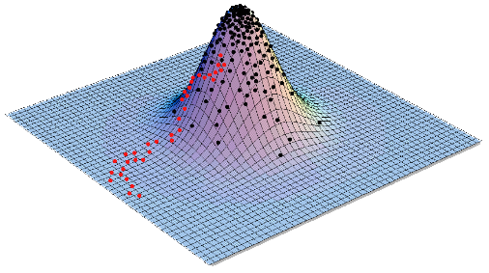
Approximating the Joint Posterior Probability Density using MCMC
Programming our MCMC robot...
Our robot parachutes into a random location in the joint posterior density
and will explore parameter space by following these simple rules:
1. If the proposed step will take the robot uphill, it automatically takes the step
2. If the proposed step will take the robot downhill, it divides the elevation of the proposed location by the current location, and it only takes the step if the quotient is less than a uniform random variable, Uniform[0,1]
3. The proposal distribution is symmetrical, so Pr[A B] = Pr[B A]
Metropolis et al. (1953); Hastings (1970)

Slide 26
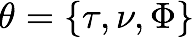
Approximating the Joint Posterior Probability Density using MCMC
The Metropolis-Hastings algorithm
1. Initialize the chain with some random values for all parameters, including the tree with branch lengths,
Metropolis et al. (1953); Hastings (1970)

Slide 27
Approximating the Joint Posterior Probability Density using MCMC
The Metropolis-Hastings algorithm
1. Initialize the chain with some random values for all parameters, including the tree with branch lengths,
2. Select a parameter to update (alter) according to the proposal probabilities
Metropolis et al. (1953); Hastings (1970)

Slide 28
Approximating the Joint Posterior Probability Density using MCMC
The Metropolis-Hastings algorithm
1. Initialize the chain with some random values for all parameters, including the tree with branch lengths,
2. Select a parameter to update (alter) according to the proposal probabilities
parameter
prior distribution
proposal weights
pi ~ dnDirichlet(pi_prior)
#moves for base frequencies
moves[++mi] = mvSimplexElementScale(pi, alpha=10.0, tune=true, weight=1.0)
er ~ dnDirichlet(er_prior)
#moves for exchangeability rates
moves[++mi] = mvSimplexElementScale(er, alpha=10.0, tune=true, weight=1.0)
alpha ~ dnUnif( alpha_prior_min, alpha_prior_max )
#moves for alpha-shape parameter
moves[++mi] = mvScale(alpha, lambda=0.8, tune=true, weight=1.0)
Metropolis et al. (1953); Hastings (1970)

Slide 29
Approximating the Joint Posterior Probability Density using MCMC
The Metropolis-Hastings algorithm
1. Initialize the chain with some random values for all parameters, including the tree with branch lengths,
2. Select a parameter to update (alter) according to the proposal probabilities
parameter
prior distribution
proposal weights
pi ~ dnDirichlet(pi_prior)
#moves for base frequencies
moves[++mi] = mvSimplexElementScale(pi, alpha=10.0, tune=true, weight=1.0)
er ~ dnDirichlet(er_prior)
#moves for exchangeability rates
moves[++mi] = mvSimplexElementScale(er, alpha=10.0, tune=true, weight=1.0)
alpha ~ dnUnif( alpha_prior_min, alpha_prior_max )
#moves for alpha-shape parameter
moves[++mi] = mvScale(alpha, lambda=0.8, tune=true, weight=4.0)
Metropolis et al. (1953); Hastings (1970)

Slide 30
Approximating the Joint Posterior Probability Density using MCMC
The Metropolis-Hastings algorithm
1. Initialize the chain with some random values for all parameters, including the tree with branch lengths,
2. Select a parameter to update (alter) according to the proposal probabilities
3. Propose a new value, , for the selected parameter via the proposal mechanism:
each parameter has a prior probability distribution of a specific form (uniform, etc.)
each prior probability distribution has one or more proposal mechanisms
Metropolis et al. (1953); Hastings (1970)

Slide 31
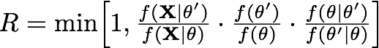
Approximating the Joint Posterior Probability Density using MCMC
The Metropolis-Hastings algorithm
1. Initialize the chain with some random values for all parameters, including the tree with branch lengths,
2. Select a parameter to update (alter) according to the proposal probabilities
3. Propose a new value, , for the selected parameter via the proposal mechanism:
each parameter has a prior probability distribution of a specific form (uniform, etc.)
each prior probability distribution has one or more proposal mechanisms
4. Calculate the probability of accepting the proposed change:
likelihood ratio
prior ratio
proposal ratio
Metropolis et al. (1953); Hastings (1970)

Slide 32
Approximating the Joint Posterior Probability Density using MCMC
The Metropolis-Hastings algorithm
1. Initialize the chain with some random values for all parameters, including the tree with branch lengths,
2. Select a parameter to update (alter) according to the proposal probabilities
3. Propose a new value, , for the selected parameter via the proposal mechanism:
each parameter has a prior probability distribution of a specific form (uniform, etc.)
each prior probability distribution has one or more proposal mechanisms
4. Calculate the probability of accepting the proposed change:
the proposal ratio is (usually) 1, so it can (usually) be ignored
likelihood ratio
prior ratio
proposal ratio
Metropolis et al. (1953); Hastings (1970)

Slide 33
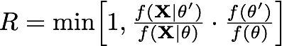
Approximating the Joint Posterior Probability Density using MCMC
The Metropolis-Hastings algorithm
1. Initialize the chain with some random values for all parameters, including the tree with branch lengths,
2. Select a parameter to update (alter) according to the proposal probabilities
3. Propose a new value, , for the selected parameter via the proposal mechanism:
each parameter has a prior probability distribution of a specific form (uniform, etc.)
each prior probability distribution has one or more proposal mechanisms
4. Calculate the probability of accepting the proposed change:
the proposal ratio is (usually) 1, so it can (usually) be ignored
likelihood ratio
prior ratio
Metropolis et al. (1953); Hastings (1970)

Slide 34
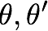
Approximating the Joint Posterior Probability Density using MCMC
The Metropolis-Hastings algorithm
1. Initialize the chain with some random values for all parameters, including the tree with branch lengths,
2. Select a parameter to update (alter) according to the proposal probabilities
3. Propose a new value, , for the selected parameter via the proposal mechanism:
each parameter has a prior probability distribution of a specific form (uniform, etc.)
each prior probability distribution has one or more proposal mechanisms
4. Calculate the probability of accepting the proposed change:
How do we calculate the likelihood for a given parameter value, ?
likelihood ratio
prior ratio
Metropolis et al. (1953); Hastings (1970)

Slide 35
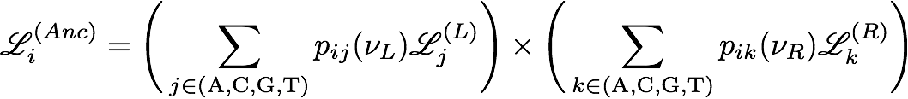
How Do We Calculate Site Likelihoods?
The Felsenstein Pruning Algorithm
Then we need to repeat the entire process for each of the more inclusive nodes toward the root, where the conditional likelihoods of the tips are first recorded...

Slide 36
How Do We Calculate Site Likelihoods?
The Felsenstein Pruning Algorithm
Then we need to repeat the entire process for each of the more inclusive nodes toward the root, where the conditional likelihoods of the tips are first recorded...

Slide 37
How Do We Calculate Site Likelihoods?
The Felsenstein Pruning Algorithm
Then we need to repeat the entire process for each of the more inclusive nodes toward the root, where the conditional likelihoods of the tips are first recorded...

Slide 38
How Do We Calculate Site Likelihoods?
The Felsenstein Pruning Algorithm
Then we need to repeat the entire process for each of the more inclusive nodes toward the root, where the conditional likelihoods of the tips are first recorded...

Slide 39
How Do We Calculate Site Likelihoods?
The Felsenstein Pruning Algorithm
Then we need to repeat the entire process for each of the more inclusive nodes toward the root, where the conditional likelihoods of the tips are first recorded...

Slide 40
How Do We Calculate Site Likelihoods?
The Felsenstein Pruning Algorithm
Then we need to repeat the entire process for each of the more inclusive nodes toward the root, where the conditional likelihoods of the tips are first recorded...

Slide 41
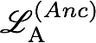
How Do We Calculate Site Likelihoods?
The Felsenstein Pruning Algorithm
Then we need to repeat the entire process for each of the more inclusive nodes toward the root, where the conditional likelihoods of the tips are first recorded, then we loop over the internal nodes in a post-order traversal…

Slide 42
How Do We Calculate Site Likelihoods?
The Felsenstein Pruning Algorithm
Then we need to repeat the entire process for each of the more inclusive nodes toward the root, where the conditional likelihoods of the tips are first recorded, then we loop over the internal nodes in a post-order traversal…

Slide 43
How Do We Calculate Site Likelihoods?
The Felsenstein Pruning Algorithm
Then we need to repeat the entire process for each of the more inclusive nodes toward the root, where the conditional likelihoods of the tips are first recorded, then we loop over the internal nodes in a post-order traversal…

Slide 44
How Do We Calculate Site Likelihoods?
The Felsenstein Pruning Algorithm
Then we need to repeat the entire process for each of the more inclusive nodes toward the root, where the conditional likelihoods of the tips are first recorded, then we loop over the internal nodes in a post-order traversal…

Slide 45
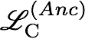
How Do We Calculate Site Likelihoods?
The Felsenstein Pruning Algorithm
Then we need to repeat the entire process for each of the more inclusive nodes toward the root, where the conditional likelihoods of the tips are first recorded, then we loop over the internal nodes in a post-order traversal…

Slide 46
How Do We Calculate Site Likelihoods?
The Felsenstein Pruning Algorithm
Then we need to repeat the entire process for each of the more inclusive nodes toward the root, where the conditional likelihoods of the tips are first recorded, then we loop over the internal nodes in a post-order traversal…

Slide 47
How Do We Calculate Site Likelihoods?
The Felsenstein Pruning Algorithm
Then we need to repeat the entire process for each of the more inclusive nodes toward the root, where the conditional likelihoods of the tips are first recorded, then we loop over the internal nodes in a post-order traversal…

Slide 48
How Do We Calculate Site Likelihoods?
The Felsenstein Pruning Algorithm
Then we need to repeat the entire process for each of the more inclusive nodes toward the root, where the conditional likelihoods of the tips are first recorded, then we loop over the internal nodes in a post-order traversal…

Slide 49
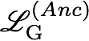
How Do We Calculate Site Likelihoods?
The Felsenstein Pruning Algorithm
Then we need to repeat the entire process for each of the more inclusive nodes toward the root, where the conditional likelihoods of the tips are first recorded, then we loop over the internal nodes in a post-order traversal…

Slide 50
How Do We Calculate Site Likelihoods?
The Felsenstein Pruning Algorithm
Then we need to repeat the entire process for each of the more inclusive nodes toward the root, where the conditional likelihoods of the tips are first recorded, then we loop over the internal nodes in a post-order traversal…

Slide 51
How Do We Calculate Site Likelihoods?
The Felsenstein Pruning Algorithm
Then we need to repeat the entire process for each of the more inclusive nodes toward the root, where the conditional likelihoods of the tips are first recorded, then we loop over the internal nodes in a post-order traversal…

Slide 52
How Do We Calculate Site Likelihoods?
The Felsenstein Pruning Algorithm
Then we need to repeat the entire process for each of the more inclusive nodes toward the root, where the conditional likelihoods of the tips are first recorded, then we loop over the internal nodes in a post-order traversal…

Slide 53
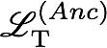
How Do We Calculate Site Likelihoods?
The Felsenstein Pruning Algorithm
Then we need to repeat the entire process for each of the more inclusive nodes toward the root, where the conditional likelihoods of the tips are first recorded, then we loop over the internal nodes in a post-order traversal…

Slide 54
How Do We Calculate Site Likelihoods?
The Felsenstein Pruning Algorithm
Then we need to repeat the entire process for each of the more inclusive nodes toward the root, where the conditional likelihoods of the tips are first recorded, then we loop over the internal nodes in a post-order traversal…

Slide 55
How Do We Calculate Site Likelihoods?
The Felsenstein Pruning Algorithm
Then we need to repeat the entire process for each of the more inclusive nodes toward the root, where the conditional likelihoods of the tips are first recorded, then we loop over the internal nodes in a post-order traversal…

Slide 56
How Do We Calculate Site Likelihoods?
The Felsenstein Pruning Algorithm
Then we need to repeat the entire process for each of the more inclusive nodes toward the root, where the conditional likelihoods of the tips are first recorded, then we loop over the internal nodes in a post-order traversal…

Slide 57
How Do We Calculate Site Likelihoods?
The Felsenstein Pruning Algorithm
Then we need to repeat the entire process for each of the more inclusive nodes toward the root, where the conditional likelihoods of the tips are first recorded, then we loop over the internal nodes in a post-order traversal…

Slide 58
How Do We Calculate Site Likelihoods?
The Felsenstein Pruning Algorithm
Then we need to repeat the entire process for each of the more inclusive nodes toward the root, where the conditional likelihoods of the tips are first recorded, then we loop over the internal nodes in a post-order traversal…

Slide 59
How Do We Calculate Site Likelihoods?
The Felsenstein Pruning Algorithm
Then we need to repeat the entire process for each of the more inclusive nodes toward the root, where the conditional likelihoods of the tips are first recorded, then we loop over the internal nodes in a post-order traversal…

Slide 60
How Do We Calculate Site Likelihoods?
The Felsenstein Pruning Algorithm
Then we need to repeat the entire process for each of the more inclusive nodes toward the root, where the conditional likelihoods of the tips are first recorded, then we loop over the internal nodes in a post-order traversal…

Slide 61
How Do We Calculate Site Likelihoods?
The Felsenstein Pruning Algorithm
Then we need to repeat the entire process for each of the more inclusive nodes toward the root, where the conditional likelihoods of the tips are first recorded, then we loop over the internal nodes in a post-order traversal…

Slide 62
How Do We Calculate Site Likelihoods?
The Felsenstein Pruning Algorithm
Then we need to repeat the entire process for each of the more inclusive nodes toward the root, where the conditional likelihoods of the tips are first recorded, then we loop over the internal nodes in a post-order traversal…

Slide 63
How Do We Calculate Site Likelihoods?
The Felsenstein Pruning Algorithm
Then we need to repeat the entire process for each of the more inclusive nodes toward the root, where the conditional likelihoods of the tips are first recorded, then we loop over the internal nodes in a post-order traversal…

Slide 64
How Do We Calculate Site Likelihoods?
The Felsenstein Pruning Algorithm
Then we need to repeat the entire process for each of the more inclusive nodes toward the root, where the conditional likelihoods of the tips are first recorded, then we loop over the internal nodes in a post-order traversal…

Slide 65
How Do We Calculate Site Likelihoods?
The Felsenstein Pruning Algorithm
Then we need to repeat the entire process for each of the more inclusive nodes toward the root, where the conditional likelihoods of the tips are first recorded, then we loop over the internal nodes in a post-order traversal…

Slide 66
How Do We Calculate Site Likelihoods?
The Felsenstein Pruning Algorithm
Then we need to repeat the entire process for each of the more inclusive nodes toward the root, where the conditional likelihoods of the tips are first recorded, then we loop over the internal nodes in a post-order traversal…

Slide 67
How Do We Calculate Site Likelihoods?
The Felsenstein Pruning Algorithm
Then we need to repeat the entire process for each of the more inclusive nodes toward the root, where the conditional likelihoods of the tips are first recorded, then we loop over the internal nodes in a post-order traversal…

Slide 68
How Do We Calculate Site Likelihoods?
The Felsenstein Pruning Algorithm
Then we need to repeat the entire process for each of the more inclusive nodes toward the root, where the conditional likelihoods of the tips are first recorded, then we loop over the internal nodes in a post-order traversal…

Slide 69
How Do We Calculate Site Likelihoods?
The Felsenstein Pruning Algorithm
Then we need to repeat the entire process for each of the more inclusive nodes toward the root, where the conditional likelihoods of the tips are first recorded, then we loop over the internal nodes in a post-order traversal…

Slide 70
How Do We Calculate Site Likelihoods?
The Felsenstein Pruning Algorithm
Then we need to repeat the entire process for each of the more inclusive nodes toward the root, where the conditional likelihoods of the tips are first recorded, then we loop over the internal nodes in a post-order traversal…

Slide 71
How Do We Calculate Site Likelihoods?
The Felsenstein Pruning Algorithm
Then we need to repeat the entire process for each of the more inclusive nodes toward the root, where the conditional likelihoods of the tips are first recorded, then we loop over the internal nodes in a post-order traversal…

Slide 72
How Do We Calculate Site Likelihoods?
The Felsenstein Pruning Algorithm
Then we need to repeat the entire process for each of the more inclusive nodes toward the root, where the conditional likelihoods of the tips are first recorded, then we loop over the internal nodes in a post-order traversal…

Slide 73
How Do We Calculate Site Likelihoods?
The Felsenstein Pruning Algorithm
Then we need to repeat the entire process for each of the more inclusive nodes toward the root, where the conditional likelihoods of the tips are first recorded, then we loop over the internal nodes in a post-order traversal…

Slide 74
How Do We Calculate Site Likelihoods?
The Felsenstein Pruning Algorithm
Then we need to repeat the entire process for each of the more inclusive nodes toward the root, where the conditional likelihoods of the tips are first recorded, then we loop over the internal nodes in a post-order traversal…

Slide 75
How Do We Calculate Site Likelihoods?
The Felsenstein Pruning Algorithm
Then we need to repeat the entire process for each of the more inclusive nodes toward the root, where the conditional likelihoods of the tips are first recorded, then we loop over the internal nodes in a post-order traversal…

Slide 76
How Do We Calculate Site Likelihoods?
The Felsenstein Pruning Algorithm
Then we need to repeat the entire process for each of the more inclusive nodes toward the root, where the conditional likelihoods of the tips are first recorded, then we loop over the internal nodes in a post-order traversal…

Slide 77
How Do We Calculate Site Likelihoods?
The Felsenstein Pruning Algorithm
Then we need to repeat the entire process for each of the more inclusive nodes toward the root, where the conditional likelihoods of the tips are first recorded, then we loop over the internal nodes in a post-order traversal…

Slide 78
How Do We Calculate Site Likelihoods?
The Felsenstein Pruning Algorithm
Then we need to repeat the entire process for each of the more inclusive nodes toward the root, where the conditional likelihoods of the tips are first recorded, then we loop over the internal nodes in a post-order traversal…

Slide 79
How Do We Calculate Site Likelihoods?
The Felsenstein Pruning Algorithm
Then we need to repeat the entire process for each of the more inclusive nodes toward the root, where the conditional likelihoods of the tips are first recorded, then we loop over the internal nodes in a post-order traversal…

Slide 80
How Do We Calculate Site Likelihoods?
The Felsenstein Pruning Algorithm
Then we need to repeat the entire process for each of the more inclusive nodes toward the root, where the conditional likelihoods of the tips are first recorded, then we loop over the internal nodes in a post-order traversal…

Slide 81
How Do We Calculate Site Likelihoods?
The Felsenstein Pruning Algorithm
Then we need to repeat the entire process for each of the more inclusive nodes toward the root, where the conditional likelihoods of the tips are first recorded, then we loop over the internal nodes in a post-order traversal…

Slide 82
How Do We Calculate Site Likelihoods?
The Felsenstein Pruning Algorithm
Then we need to repeat the entire process for each of the more inclusive nodes toward the root, where the conditional likelihoods of the tips are first recorded, then we loop over the internal nodes in a post-order traversal…

Slide 83
How Do We Calculate Site Likelihoods?
The Felsenstein Pruning Algorithm
Then we need to repeat the entire process for each of the more inclusive nodes toward the root, where the conditional likelihoods of the tips are first recorded, then we loop over the internal nodes in a post-order traversal…

Slide 84
How Do We Calculate Site Likelihoods?
The Felsenstein Pruning Algorithm
Then we need to repeat the entire process for each of the more inclusive nodes toward the root, where the conditional likelihoods of the tips are first recorded, then we loop over the internal nodes in a post-order traversal…

Slide 85
How Do We Calculate Site Likelihoods?
The Felsenstein Pruning Algorithm
Then we need to repeat the entire process for each of the more inclusive nodes toward the root, where the conditional likelihoods of the tips are first recorded, then we loop over the internal nodes in a post-order traversal…

Slide 86
How Do We Calculate Site Likelihoods?
The Felsenstein Pruning Algorithm
Then we need to repeat the entire process for each of the more inclusive nodes toward the root, where the conditional likelihoods of the tips are first recorded, then we loop over the internal nodes in a post-order traversal…

Slide 87
How Do We Calculate Site Likelihoods?
The Felsenstein Pruning Algorithm
Then we need to repeat the entire process for each of the more inclusive nodes toward the root, where the conditional likelihoods of the tips are first recorded, then we loop over the internal nodes in a post-order traversal…

Slide 88
How Do We Calculate Site Likelihoods?
The Felsenstein Pruning Algorithm
Then we need to repeat the entire process for each of the more inclusive nodes toward the root, where the conditional likelihoods of the tips are first recorded, then we loop over the internal nodes in a post-order traversal…

Slide 89
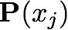
How Do We Calculate Site Likelihoods?
The Felsenstein Pruning Algorithm
Upon reaching the root of the tree, the conditional likelihood of each state is ‘weighted’ by the prior probability (stationary frequency) of the corresponding state, , to give the unconditional probability of the j^{th} site, .
π
i

Slide 90
Approximating the Joint Posterior Probability Density using MCMC
The Metropolis-Hastings algorithm
1. Initialize the chain with some random values for all parameters, including the tree with branch lengths,
2. Select a parameter to update (alter) according to the proposal probabilities
3. Propose a new value, , for the selected parameter via the proposal mechanism:
each parameter has a prior probability distribution of a specific form (uniform, etc.)
each prior probability distribution has one or more proposal mechanisms
4. Calculate the probability of accepting the proposed change:
How do we calculate the prior probability for a given parameter value, ?
likelihood ratio
prior ratio
Metropolis et al. (1953); Hastings (1970)

Slide 91
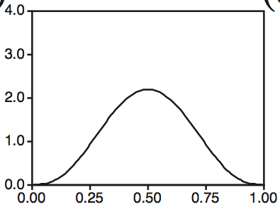
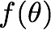
Approximating the Joint Posterior Probability Density using MCMC
Bayesian Inference
The prior for each parameter is specified
We can just look up the prior probability of a given parameter value .

Slide 92
Approximating the Joint Posterior Probability Density using MCMC
Bayesian Inference
The prior for each parameter is specified
We can just look up the prior probability of a given parameter value .

Slide 93
Approximating the Joint Posterior Probability Density using MCMC
Bayesian Inference
The prior for each parameter is specified
We can just look up the prior probability of a given parameter value .

Slide 94
Approximating the Joint Posterior Probability Density using MCMC
Bayesian Inference
The prior for each parameter is specified
We can just look up the prior probability of a given parameter value .

Slide 95
Approximating the Joint Posterior Probability Density using MCMC
The Metropolis-Hastings algorithm
1. Initialize the chain with some random values for all parameters, including the tree with branch lengths,
2. Select a parameter to update (alter) according to the proposal probabilities
3. Propose a new value, , for the selected parameter via the proposal mechanism:
each parameter has a prior probability distribution of a specific form (uniform, etc.)
each prior probability distribution has one or more proposal mechanisms
4. Calculate the probability of accepting the proposed change:
That means we compute R based only on the ratio of the product of the likelihood and the prior probability of the current and proposed parameter values,
likelihood ratio
prior ratio
Metropolis et al. (1953); Hastings (1970)

Slide 96
Approximating the Joint Posterior Probability Density using MCMC
The Metropolis-Hastings algorithm
1. Initialize the chain with some random values for all parameters, including the tree with branch lengths,
2. Select a parameter to update (alter) according to the proposal probabilities
3. Propose a new value, , for the selected parameter via the proposal mechanism:
each parameter has a prior probability distribution of a specific form (uniform, etc.)
each prior probability distribution has one or more proposal mechanisms
4. Calculate the probability of accepting the proposed change:
i.e., we decide how to explore the posterior probability density based on the ratio of the posterior probabilities of the current and proposed parameter values,
Metropolis et al. (1953); Hastings (1970)

Slide 97
Approximating the Joint Posterior Probability Density using MCMC
The Metropolis-Hastings algorithm
1. Initialize the chain with some random values for all parameters, including the tree with branch lengths,
2. Select a parameter to update (alter) according to the proposal probabilities
3. Propose a new value, , for the selected parameter via the proposal mechanism:
each parameter has a prior probability distribution of a specific form (uniform, etc.)
each prior probability distribution has one or more proposal mechanisms
4. Calculate the probability of accepting the proposed change:
i.e., we decide how to explore the posterior probability density based on the ratio of the posterior probabilities of the current and proposed parameter values,
posterior probability of proposed state
Metropolis et al. (1953); Hastings (1970)

Slide 98
Approximating the Joint Posterior Probability Density using MCMC
The Metropolis-Hastings algorithm
1. Initialize the chain with some random values for all parameters, including the tree with branch lengths,
2. Select a parameter to update (alter) according to the proposal probabilities
3. Propose a new value, , for the selected parameter via the proposal mechanism:
each parameter has a prior probability distribution of a specific form (uniform, etc.)
each prior probability distribution has one or more proposal mechanisms
4. Calculate the probability of accepting the proposed change:
i.e., we decide how to explore the posterior probability density based on the ratio of the posterior probabilities of the current and proposed parameter values,
posterior probability of proposed state
posterior probability of current state
Metropolis et al. (1953); Hastings (1970)

Slide 99
Approximating the Joint Posterior Probability Density using MCMC
The Metropolis-Hastings algorithm
1. Initialize the chain with some random values for all parameters, including the tree with branch lengths,
2. Select a parameter to update (alter) according to the proposal probabilities
3. Propose a new value, , for the selected parameter via the proposal mechanism:
each parameter has a prior probability distribution of a specific form (uniform, etc.)
each prior probability distribution has one or more proposal mechanisms
4. Calculate the probability of accepting the proposed change:
That means we can explore the posterior probability density without having to compute the marginal likelihood!!
likelihood function
prior probability
posterior probability
marginal likelihood
Metropolis et al. (1953); Hastings (1970)

Slide 100
Approximating the Joint Posterior Probability Density using MCMC
The Metropolis-Hastings algorithm
1. Initialize the chain with some random values for all parameters, including the tree with branch lengths,
2. Select a parameter to update (alter) according to the proposal probabilities
3. Propose a new value, , for the selected parameter via the proposal mechanism:
each parameter has a prior probability distribution of a specific form (uniform, etc.)
each prior probability distribution has one or more proposal mechanisms
4. Calculate the probability of accepting the proposed change, R
5. Generate a uniform random variable, U[0,1], accept if R > U
Metropolis et al. (1953); Hastings (1970)

Slide 101
Approximating the Joint Posterior Probability Density using MCMC
The Metropolis-Hastings algorithm
1. Initialize the chain with some random values for all parameters, including the tree with branch lengths,
2. Select a parameter to update (alter) according to the proposal probabilities
3. Propose a new value, , for the selected parameter via the proposal mechanism:
each parameter has a prior probability distribution of a specific form (uniform, etc.)
each prior probability distribution has one or more proposal mechanisms
4. Calculate the probability of accepting the proposed change, R
5. Generate a uniform random variable, U[0,1], accept if R > U
6. Repeat steps 2–5 an ‘adequate’ number of times
Metropolis et al. (1953); Hastings (1970)

Slide 102

Approximating the Joint Posterior Probability Density using MCMC
The Metropolis-Hastings algorithm
Probability
= 0.05

Slide 103
Approximating the Joint Posterior Probability Density using MCMC
The Metropolis-Hastings algorithm
= 0.1
Probability
= 0.05

Slide 104
Approximating the Joint Posterior Probability Density using MCMC
The Metropolis-Hastings algorithm
= 0.1
Probability
= 0.05
likelihood ratio
prior ratio
proposal ratio

Slide 105
Approximating the Joint Posterior Probability Density using MCMC
The Metropolis-Hastings algorithm
= 0.1
Probability
= 0.05
likelihood ratio
prior ratio

Slide 106
Approximating the Joint Posterior Probability Density using MCMC
The Metropolis-Hastings algorithm
= 0.1
Probability
= 0.05
posterior ratio

Slide 107
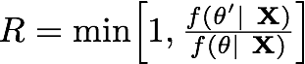
Approximating the Joint Posterior Probability Density using MCMC
The Metropolis-Hastings algorithm
= 0.1
Probability
= 0.05
posterior ratio

Slide 108
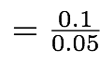
Approximating the Joint Posterior Probability Density using MCMC
The Metropolis-Hastings algorithm
= 0.1
Probability
= 0.05

Slide 109
Approximating the Joint Posterior Probability Density using MCMC
The Metropolis-Hastings algorithm
= 0.1
Probability
= 0.05

Slide 110
Approximating the Joint Posterior Probability Density using MCMC
The Metropolis-Hastings algorithm
= 0.1
Probability
= 0.05
Probability
0
U
1

Slide 111
Approximating the Joint Posterior Probability Density using MCMC
The Metropolis-Hastings algorithm
= 0.1
Probability
= 0.05
Probability
0
U
1

Slide 112
Approximating the Joint Posterior Probability Density using MCMC
The Metropolis-Hastings algorithm
= 0.1
Probability
= 0.05
Probability
Accept
0
U
1

Slide 113
Approximating the Joint Posterior Probability Density using MCMC
The Metropolis-Hastings algorithm
= 0.1
Probability
Probability
Accept
0
U
1

Slide 114
Approximating the Joint Posterior Probability Density using MCMC
The Metropolis-Hastings algorithm
= 0.1
Probability
Probability
0
U
1

Slide 115
Approximating the Joint Posterior Probability Density using MCMC
The Metropolis-Hastings algorithm
= 0.1
Probability
= 0.05
Probability
0
U
1

Slide 116
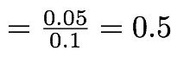
Approximating the Joint Posterior Probability Density using MCMC
The Metropolis-Hastings algorithm
= 0.1
Probability
= 0.05
Probability
0
U
1

Slide 117
Approximating the Joint Posterior Probability Density using MCMC
The Metropolis-Hastings algorithm
= 0.1
Probability
= 0.05
Probability
0
U
1

Slide 118
Approximating the Joint Posterior Probability Density using MCMC
The Metropolis-Hastings algorithm
= 0.1
Probability
= 0.05
Probability
0
U
1

Slide 119
Approximating the Joint Posterior Probability Density using MCMC
The Metropolis-Hastings algorithm
= 0.1
Probability
= 0.05
Probability
Accept
Reject
0
U
1

Slide 120
Approximating the Joint Posterior Probability Density using MCMC
The Metropolis-Hastings algorithm
= 0.1
Probability
Probability
0
U
1

Slide 121
Approximating the Joint Posterior Probability Density using MCMC
The Metropolis-Hastings algorithm
= 0.1
Probability
= 0.025
Probability
0
U
1

Slide 122
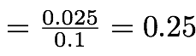
Approximating the Joint Posterior Probability Density using MCMC
The Metropolis-Hastings algorithm
= 0.1
Probability
= 0.025
Probability
0
U
1

Slide 123
Approximating the Joint Posterior Probability Density using MCMC
The Metropolis-Hastings algorithm
= 0.1
Probability
= 0.025
Probability
0
U
1

Slide 124
Approximating the Joint Posterior Probability Density using MCMC
The Metropolis-Hastings algorithm
= 0.1
Probability
= 0.025
Probability
0
U
1

Slide 125
Approximating the Joint Posterior Probability Density using MCMC
The Metropolis-Hastings algorithm
= 0.1
Probability
= 0.025
Probability
Accept
Reject
0
U
1

Slide 126

Approximating the Joint Posterior Probability Density using MCMC
iMCMC demonstration
John Huelsenbeck (inspired by MCMC Robot by Paul Lewis)

Slide 127
Bayesian Inference of Phylogeny (on one slide)
I. Data
Assume an alignment, X, of N sites for S species:
II. Phylogenetic model parameters
IV. Priors on parameters
1. Tree
topology
~Uniform
branch lengths
~Dirichlet (1,...,1)
2. Model of character change
relative substitution rates
~Dirichlet (1,1,1,1,1,1)
stationary frequencies
~Dirichlet (1,1,1,1)
III. Phylogenetic likelihood function
V. Posterior Probability

Slide 128
Bayesian Inference of Phylogeny (on one slide)
I. Data
Assume an alignment, X, of N sites for S species:
II. Phylogenetic model parameters
IV. Priors on parameters
1. Tree
topology
~Uniform
branch lengths
~Dirichlet (1,...,1)
2. Model of character change
relative substitution rates
~Dirichlet (1,1,1,1,1,1)
stationary frequencies
~Dirichlet (1,1,1,1)
III. Phylogenetic likelihood function
V. Posterior Probability

Slide 129
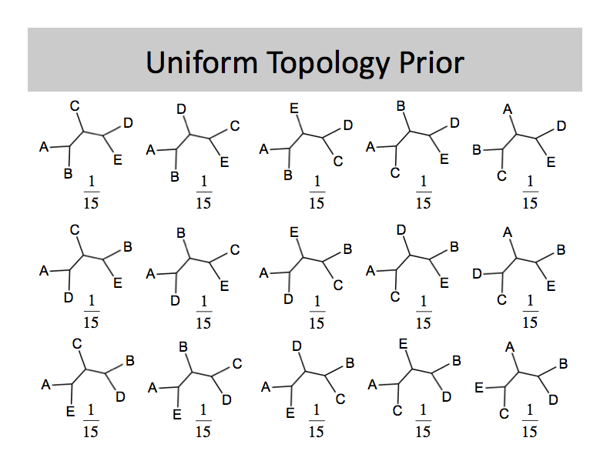
Approximating the Joint Posterior Probability Density using MCMC
Discrete-uniform prior on topologies

Slide 130
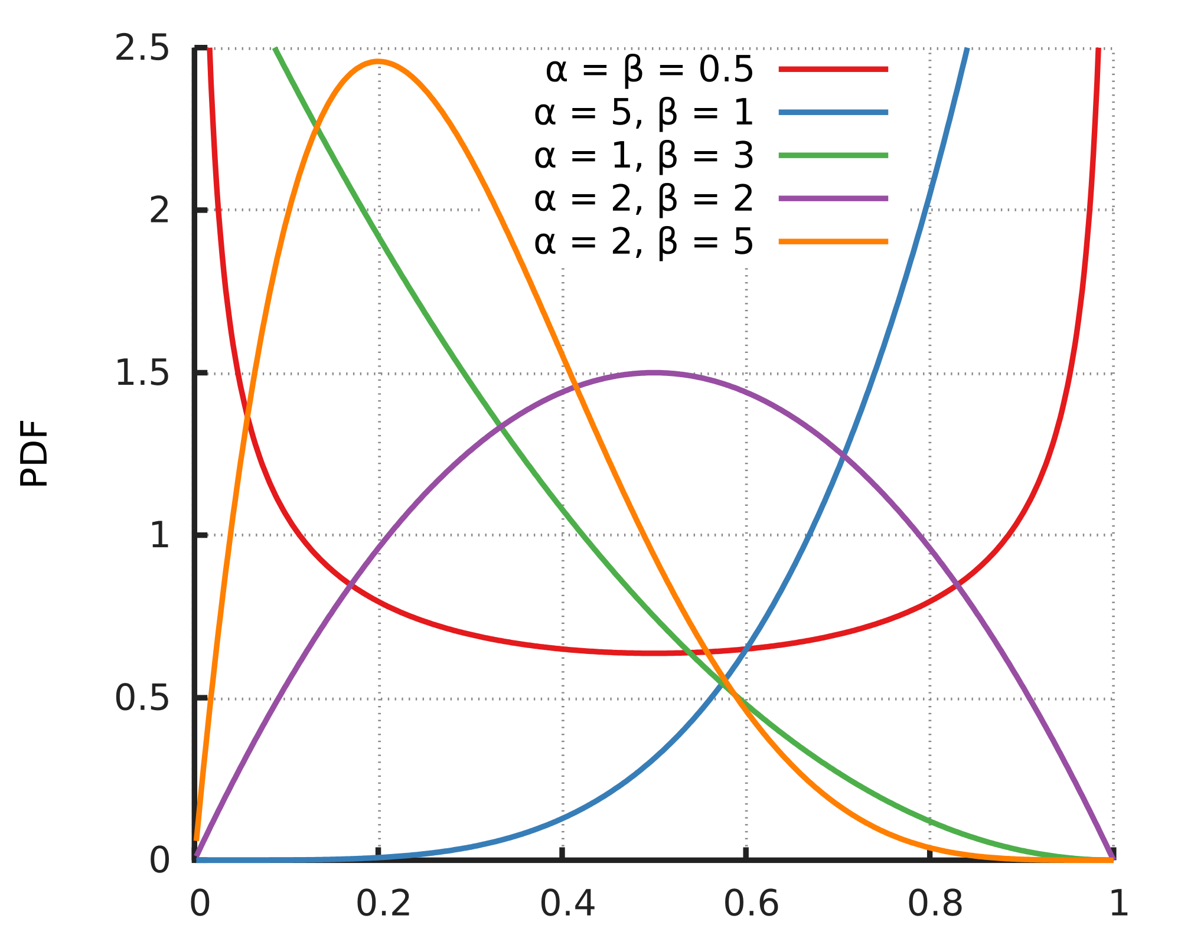
Approximating the Joint Posterior Probability Density using MCMC
Beta prior

Slide 131
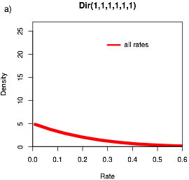
Approximating the Joint Posterior Probability Density using MCMC
Dirichlet prior
Generalization of the beta often used for proportions

Slide 132
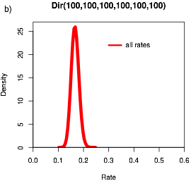
Approximating the Joint Posterior Probability Density using MCMC
Dirichlet prior
Generalization of the beta often used for proportions

Slide 133
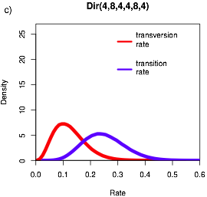
Approximating the Joint Posterior Probability Density using MCMC
Dirichlet prior
Generalization of the beta often used for proportions

Slide 134
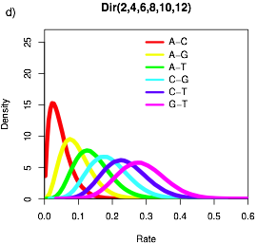
Approximating the Joint Posterior Probability Density using MCMC
Dirichlet prior
Generalization of the beta often used for proportions

Slide 135
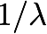
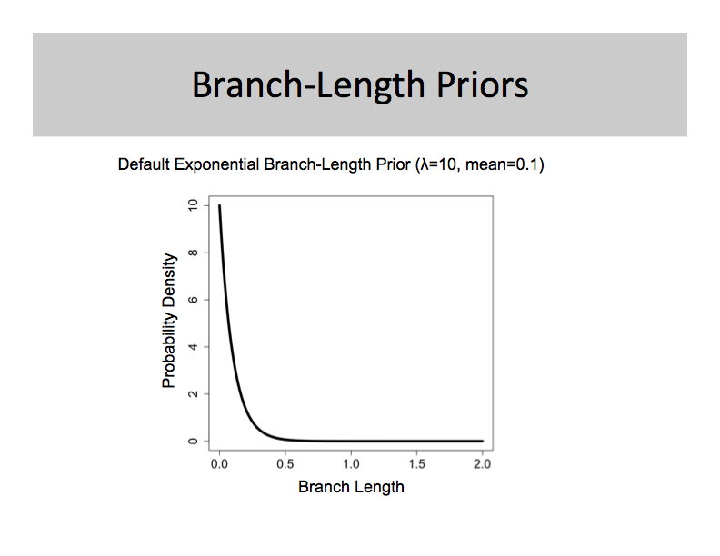
Approximating the Joint Posterior Probability Density using MCMC
Exponential priors
Often used for branch lengths with rate parameter and mean
Probability density
Branch length

Slide 136
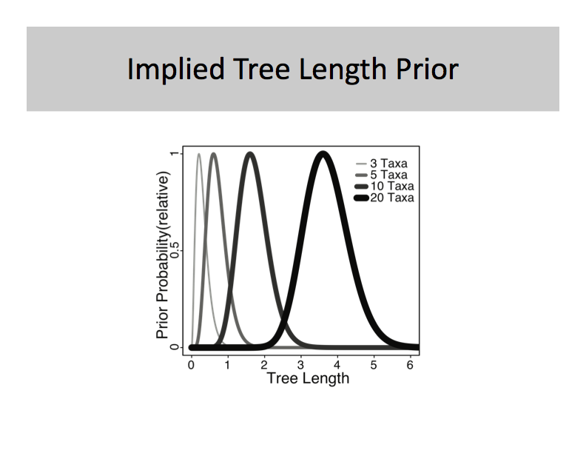
Approximating the Joint Posterior Probability Density using MCMC
Gamma prior
May be used for tree length (sum of branch lengths)
Probability density
Tree length

Slide 137
Approximating the Joint Posterior Probability Density using MCMC
The Metropolis-Hastings algorithm
1. Initialize the chain with some random values for all parameters, including the tree with branch lengths,
2. Select a parameter to update (alter) according to the proposal probabilities
3. Propose a new value, , for the selected parameter via the proposal mechanism:
each parameter has a prior probability distribution of a specific form (uniform, etc.)
each prior probability distribution has one or more proposal mechanisms
4. Calculate the probability of accepting the proposed change, R
5. Generate a uniform random variable, U[0,1], accept if R > U
6. Repeat steps 2–5 an ‘adequate’ number of times
Metropolis et al. (1953); Hastings (1970)

Slide 138
Approximating the Joint Posterior Probability Density using MCMC
Scale of the tuning parameter is important for MCMC efficiency
John Huelsenbeck (inspired by MCMC Robot by Paul Lewis)

Slide 139
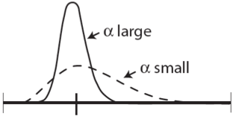
Approximating the Joint Posterior Probability Density using MCMC
Dirichlet proposal mechanism
current parameter value
Propose a new value for a parameter with a Dirichlet prior probability density
the proposal density is controlled by the tuning parameter,
when is large, smaller changes will be proposed
when is small, larger changes will be proposed
pi ~ dnDirichlet(pi_prior)
moves[++mi] = mvSimplexElementScale(pi, alpha=10.0, tune=true, weight=2.0)

Slide 140

Approximating the Joint Posterior Probability Density using MCMC
Sliding-window proposal mechanism
current parameter value
Propose a new value for a parameter with a uniform prior probability density
the proposal density is controlled by the tuning parameter,
when is large, larger changes will be proposed
when is small, smaller changes will be proposed
epsilon ~ dnUnif( epsilon_prior_min, epsilon_prior_max )
moves[++mi] = mvSlide(epsilon, delta=0.8, tune=true, weight=3.0)

Slide 141
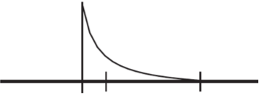
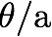
Approximating the Joint Posterior Probability Density using MCMC
Multiplier proposal mechanism
current parameter value
Propose a new value for a parameter with a exponential prior probability density
the proposal density is controlled by the tuning parameter,
when is large, larger changes will be proposed
when is small, smaller changes will be proposed
Equivalent to sliding-window proposal with log-transformed x axis
Works well when changes to small parameter values have a larger impact on probability of data than changes in large parameter values
br_lens[i] ~ dnExponential(10.0)
moves[++mi] = mvScale(br_lens[i],lambda=1,tune=true,weight=1)

Slide 142
Outline
I. Bayesian inference, redux
The anatomy and meaning of Bayes theorem
II. Numerical algorithms for Bayesian inference
Markov-chain Monte Carlo (MCMC)
Metropolis-Hastings algorithm
Metropolis-Coupled algorithm
Summarizing posterior samples
III. Diagnosing MCMC performance
Motivation and overview of the basics
IV. MCMC Diagnostics
General strategies:
diagnostics based on single chains
diagnostics based on the prior
diagnostics based on multiple, replicate chains

Slide 143
Outline
I. Bayesian inference, redux
The anatomy and meaning of Bayes theorem
II. Numerical algorithms for Bayesian inference
Markov-chain Monte Carlo (MCMC)
Metropolis-Hastings algorithm
Metropolis-Coupled algorithm
Summarizing posterior samples
III. Diagnosing MCMC performance
Motivation and overview of the basics
IV. MCMC Diagnostics
General strategies:
diagnostics based on single chains
diagnostics based on the prior
diagnostics based on multiple, replicate chains

Slide 144
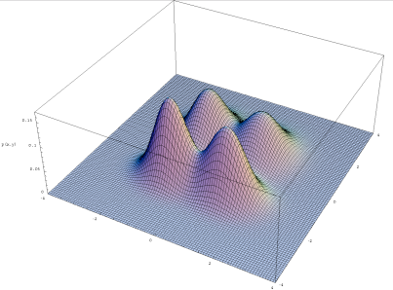
Approximating the Joint Posterior Probability Density using MCMC
Robot Squadron!!
Metropolis et al. (1953); Hastings (1970)

Slide 145
Approximating the Joint Posterior Probability Density using Metropolis-Coupled MCMC
The MC³ algorithm
1. Initialize N independent M-H MCMC chains with random values for all parameters.

Slide 146
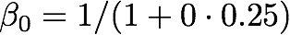
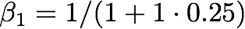
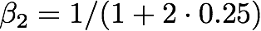
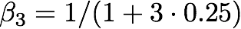
Approximating the Joint Posterior Probability Density using Metropolis-Coupled MCMC
The MC³ algorithm
1. Initialize N independent M-H MCMC chains with random values for all parameters.
2. The chains are incrementally heated, such that the first chain is cold (unmodified).
posterior of chain i is raised to a power, : the heat of chain i = 1/(1 + iT)
 | temperature
chain | 0.25 | 0.20 | 0.15 | 0.10
0 | 1.00 | 1.00 | 1.00 | 1.00
1 | 0.80 | 0.83 | 0.87 | 0.91
2 | 0.67 | 0.71 | 0.77 | 0.83
3 | 0.57 | 0.63 | 0.69 | 0.77

Slide 147
Approximating the Joint Posterior Probability Density using Metropolis-Coupled MCMC
The MC³ algorithm
1. Initialize N independent M-H MCMC chains with random values for all parameters.
2. The chains are incrementally heated, such that the first chain is cold (unmodified).
posterior of chain i is raised to a power, : the heat of chain i = 1/(1 + iT)
 | temperature
chain | 0.25 | 0.20 | 0.15 | 0.10
0 | 1.00 | 1.00 | 1.00 | 1.00
1 | 0.80 | 0.83 | 0.87 | 0.91
2 | 0.67 | 0.71 | 0.77 | 0.83
3 | 0.57 | 0.63 | 0.69 | 0.77

Slide 148
Approximating the Joint Posterior Probability Density using Metropolis-Coupled MCMC
The MC³ algorithm
1. Initialize N independent M-H MCMC chains with random values for all parameters.
2. The chains are incrementally heated, such that the first chain is cold (unmodified).
posterior of chain i is raised to a power, : the heat of chain i = 1/(1 + iT)
 | temperature
chain | 0.25 | 0.20 | 0.15 | 0.10
0 | 1.00 | 1.00 | 1.00 | 1.00
1 | 0.80 | 0.83 | 0.87 | 0.91
2 | 0.67 | 0.71 | 0.77 | 0.83
3 | 0.57 | 0.63 | 0.69 | 0.77

Slide 149
Approximating the Joint Posterior Probability Density using Metropolis-Coupled MCMC
The MC³ algorithm
1. Initialize N independent M-H MCMC chains with random values for all parameters.
2. The chains are incrementally heated, such that the first chain is cold (unmodified).
posterior of chain i is raised to a power, : the heat of chain i = 1/(1 + iT)
 | temperature
chain | 0.25 | 0.20 | 0.15 | 0.10
0 | 1.00 | 1.00 | 1.00 | 1.00
1 | 0.80 | 0.83 | 0.87 | 0.91
2 | 0.67 | 0.71 | 0.77 | 0.83
3 | 0.57 | 0.63 | 0.69 | 0.77

Slide 150
Approximating the Joint Posterior Probability Density using Metropolis-Coupled MCMC
The MC³ algorithm
1. Initialize N independent M-H MCMC chains with random values for all parameters.
2. The chains are incrementally heated, such that the first chain is cold (unmodified).
posterior of chain i is raised to a power, : the heat of chain i = 1/(1 + iT)
 | temperature
chain | 0.25 | 0.20 | 0.15 | 0.10
0 | 1.00 | 1.00 | 1.00 | 1.00
1 | 0.80 | 0.83 | 0.87 | 0.91
2 | 0.67 | 0.71 | 0.77 | 0.83
3 | 0.57 | 0.63 | 0.69 | 0.77

Slide 151
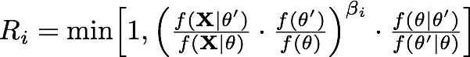
Approximating the Joint Posterior Probability Density using Metropolis-Coupled MCMC
The MC³ algorithm
1. Initialize N independent M-H MCMC chains with random values for all parameters.
2. The chains are incrementally heated, such that the first chain is cold (unmodified).
posterior of chain i is raised to a power, : the heat of chain i = 1/(1 + iT)
 | temperature
chain | 0.25 | 0.20 | 0.15 | 0.10
0 | 1.00 | 1.00 | 1.00 | 1.00
1 | 0.80 | 0.83 | 0.87 | 0.91
2 | 0.67 | 0.71 | 0.77 | 0.83
3 | 0.57 | 0.63 | 0.69 | 0.77
the incremental heating successively ‘flattens’ the posterior visited by each chain by making the acceptance probability of the i^{th} chain more ‘permissive’:

Slide 152
Approximating the Joint Posterior Probability Density using Metropolis-Coupled MCMC
The MC³ algorithm
1. Initialize N independent M-H MCMC chains with random values for all parameters.
2. The chains are incrementally heated, such that the first chain is cold (unmodified).
posterior of chain i is raised to a power, : the heat of chain i = 1/(1 + iT)
 | temperature
chain | 0.25 | 0.20 | 0.15 | 0.10
0 | 1.00 | 1.00 | 1.00 | 1.00
1 | 0.80 | 0.83 | 0.87 | 0.91
2 | 0.67 | 0.71 | 0.77 | 0.83
3 | 0.57 | 0.63 | 0.69 | 0.77
the incremental heating successively ‘flattens’ the posterior visited by each chain by making the acceptance probability of the i^{th} chain more ‘permissive’:
this allows heated chains to more readily traverse regions of low probability.

Slide 153
Approximating the Joint Posterior Probability Density using Metropolis-Coupled MCMC
The MC³ algorithm
1. Initialize N independent M-H MCMC chains with random values for all parameters.
2. The chains are incrementally heated, such that the first chain is cold (unmodified).
posterior of chain i is raised to a power, : the heat of chain i = 1/(1 + iT)
 | temperature
chain | 0.25 | 0.20 | 0.15 | 0.10
0 | 1.00 | 1.00 | 1.00 | 1.00
1 | 0.80 | 0.83 | 0.87 | 0.91
2 | 0.67 | 0.71 | 0.77 | 0.83
3 | 0.57 | 0.63 | 0.69 | 0.77
the incremental heating successively ‘flattens’ the posterior visited by each chain by making the acceptance probability of the i^{th} chain more ‘permissive’:
this allows heated chains to more readily traverse regions of low probability.
the degree of incremental heating is controlled by the temperature parameter, T.

Slide 154
Approximating the Joint Posterior Probability Density using Metropolis-Coupled MCMC
The MC³ algorithm
1. Initialize N independent M-H MCMC chains with random values for all parameters.
2. The chains are incrementally heated, such that the first chain is cold (unmodified).
posterior of chain i is raised to a power, : the heat of chain i = 1/(1 + iT)
 | temperature
chain | 0.25 | 0.20 | 0.15 | 0.10
0 | 1.00 | 1.00 | 1.00 | 1.00
1 | 0.80 | 0.83 | 0.87 | 0.91
2 | 0.67 | 0.71 | 0.77 | 0.83
3 | 0.57 | 0.63 | 0.69 | 0.77
the incremental heating successively ‘flattens’ the posterior visited by each chain by making the acceptance probability of the i^{th} chain more ‘permissive’:
this allows heated chains to more readily traverse regions of low probability.
the degree of incremental heating is controlled by the temperature parameter, T.

Slide 155
Approximating the Joint Posterior Probability Density using Metropolis-Coupled MCMC
The MC³ algorithm
1. Initialize N independent M-H MCMC chains with random values for all parameters.
2. The chains are incrementally heated, such that the first chain is cold (unmodified).
posterior of chain i is raised to a power, : the heat of chain i = 1/(1 + iT)
 | temperature
chain | 0.25 | 0.20 | 0.15 | 0.10
0 | 1.00 | 1.00 | 1.00 | 1.00
1 | 0.80 | 0.83 | 0.87 | 0.91
2 | 0.67 | 0.71 | 0.77 | 0.83
3 | 0.57 | 0.63 | 0.69 | 0.77
the incremental heating successively ‘flattens’ the posterior visited by each chain by making the acceptance probability of the i^{th} chain more ‘permissive’:
this allows heated chains to more readily traverse regions of low probability.
the degree of incremental heating is controlled by the temperature parameter, T.

Slide 156
Approximating the Joint Posterior Probability Density using Metropolis-Coupled MCMC
The MC³ algorithm
1. Initialize N independent M-H MCMC chains with random values for all parameters.
2. The chains are incrementally heated, such that the first chain is cold (unmodified).
posterior of chain i is raised to a power, : the heat of chain i = 1/(1 + iT)
 | temperature
chain | 0.25 | 0.20 | 0.15 | 0.10
0 | 1.00 | 1.00 | 1.00 | 1.00
1 | 0.80 | 0.83 | 0.87 | 0.91
2 | 0.67 | 0.71 | 0.77 | 0.83
3 | 0.57 | 0.63 | 0.69 | 0.77
the incremental heating successively ‘flattens’ the posterior visited by each chain by making the acceptance probability of the i^{th} chain more ‘permissive’:
this allows heated chains to more readily traverse regions of low probability.
the degree of incremental heating is controlled by the temperature parameter, T.

Slide 157
Approximating the Joint Posterior Probability Density using Metropolis-Coupled MCMC
The MC³ algorithm
1. Initialize N independent M-H MCMC chains with random values for all parameters.
2. The chains are incrementally heated, such that the first chain is cold (unmodified).
posterior of chain i is raised to a power, : the heat of chain i = 1/(1 + iT)
 | temperature
chain | 0.25 | 0.20 | 0.15 | 0.10
0 | 1.00 | 1.00 | 1.00 | 1.00
1 | 0.80 | 0.83 | 0.87 | 0.91
2 | 0.67 | 0.71 | 0.77 | 0.83
3 | 0.57 | 0.63 | 0.69 | 0.77
cold chain
the incremental heating successively ‘flattens’ the posterior visited by each chain by making the acceptance probability of the i^{th} chain more ‘permissive’:
this allows heated chains to more readily traverse regions of low probability.
the degree of incremental heating is controlled by the temperature parameter, T.
samples are only collected by the ‘cold’ chain (i.e., the undistorted posterior).

Slide 158
Approximating the Joint Posterior Probability Density using Metropolis-Coupled MCMC
The MC³ algorithm
1. Initialize N independent M-H MCMC chains with random values for all parameters.
2. The chains are incrementally heated, such that the first chain is cold (unmodified).
posterior of chain i is raised to a power, : the heat of chain i = 1/(1 + iT)
the cold chain samples the true posterior, whereas the heated chains sample successively ‘flattened’ distortions of the posterior
chain 0 ( = 1.00)

Slide 159

Approximating the Joint Posterior Probability Density using Metropolis-Coupled MCMC
The MC³ algorithm
1. Initialize N independent M-H MCMC chains with random values for all parameters.
2. The chains are incrementally heated, such that the first chain is cold (unmodified).
posterior of chain i is raised to a power, : the heat of chain i = 1/(1 + iT)
the cold chain samples the true posterior, whereas the heated chains sample successively ‘flattened’ distortions of the posterior
chain 0 ( = 1.00)
chain 1 ( = 0.83)

Slide 160

Approximating the Joint Posterior Probability Density using Metropolis-Coupled MCMC
The MC³ algorithm
1. Initialize N independent M-H MCMC chains with random values for all parameters.
2. The chains are incrementally heated, such that the first chain is cold (unmodified).
posterior of chain i is raised to a power, : the heat of chain i = 1/(1 + iT)
the cold chain samples the true posterior, whereas the heated chains sample successively ‘flattened’ distortions of the posterior
chain 0 ( = 1.00)
chain 1 ( = 0.83)
chain 2 ( = 0.71)

Slide 161
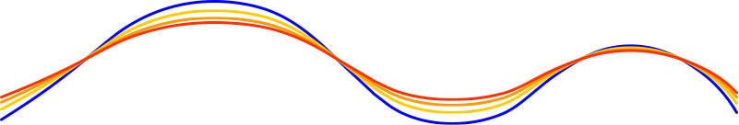
Approximating the Joint Posterior Probability Density using Metropolis-Coupled MCMC
The MC³ algorithm
1. Initialize N independent M-H MCMC chains with random values for all parameters.
2. The chains are incrementally heated, such that the first chain is cold (unmodified).
posterior of chain i is raised to a power, : the heat of chain i = 1/(1 + iT)
the cold chain samples the true posterior, whereas the heated chains sample successively ‘flattened’ distortions of the posterior
chain 0 ( = 1.00)
chain 1 ( = 0.83)
chain 2 ( = 0.71)
chain 3 ( = 0.63)

Slide 162
Approximating the Joint Posterior Probability Density using Metropolis-Coupled MCMC
The MC³ algorithm
1. Initialize N independent M-H MCMC chains with random values for all parameters.
2. The chains are incrementally heated, such that the first chain is cold (unmodified).
posterior of chain i is raised to a power, : the heat of chain i = 1/(1 + iT)
the cold chain samples the true posterior, whereas the heated chains sample successively ‘flattened’ distortions of the posterior
heated chains to more readily traverse regions of low probability
chain 0 ( = 1.00)
chain 1 ( = 0.83)
chain 2 ( = 0.71)
chain 3 ( = 0.63)

Slide 163
Approximating the Joint Posterior Probability Density using Metropolis-Coupled MCMC
The MC³ algorithm
1. Initialize N independent M-H MCMC chains with random values for all parameters.
2. The chains are incrementally heated, such that the first chain is cold (unmodified).
posterior of chain i is raised to a power, : the heat of chain i = 1/(1 + iT)
the cold chain samples the true posterior, whereas the heated chains sample successively ‘flattened’ distortions of the posterior
heated chains to more readily traverse regions of low probability
chain 0 ( = 1.00)
chain 1 ( = 0.83)
chain 2 ( = 0.71)
chain 3 ( = 0.63)

Slide 164
Approximating the Joint Posterior Probability Density using Metropolis-Coupled MCMC
The MC³ algorithm
1. Initialize N independent M-H MCMC chains with random values for all parameters.
2. The chains are incrementally heated, such that the first chain is cold (unmodified).
3. At prescribed intervals, two chains are randomly selected to swap.
chain 0 ( = 1.00)
chain 1 ( = 0.83)
chain 2 ( = 0.71)
chain 3 ( = 0.63)

Slide 165
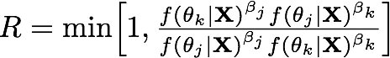
Approximating the Joint Posterior Probability Density using Metropolis-Coupled MCMC
The MC³ algorithm
1. Initialize N independent M-H MCMC chains with random values for all parameters.
2. The chains are incrementally heated, such that the first chain is cold (unmodified).
3. At prescribed intervals, two chains are randomly selected to swap.
we compute the acceptance probability of swapping the two chains.
chain 0 ( = 1.00)
chain 1 ( = 0.83)
chain 2 ( = 0.71)
chain 3 ( = 0.63)

Slide 166
Approximating the Joint Posterior Probability Density using Metropolis-Coupled MCMC
The MC³ algorithm
1. Initialize N independent M-H MCMC chains with random values for all parameters.
2. The chains are incrementally heated, such that the first chain is cold (unmodified).
3. At prescribed intervals, two chains are randomly selected to swap.
we compute the acceptance probability of swapping the two chains.
if accepted, the chains swap positions (and in computer memory)
chain 0 ( = 1.00)
chain 1 ( = 0.83)
chain 2 ( = 0.71)
chain 3 ( = 0.63)

Slide 167
Approximating the Joint Posterior Probability Density using Metropolis-Coupled MCMC
The MC³ algorithm
1. Initialize N independent M-H MCMC chains with random values for all parameters.
2. The chains are incrementally heated, such that the first chain is cold (unmodified).
3. At prescribed intervals, two chains are randomly selected to swap.
4. Only samples from the cold chain are used to approximate the posterior.
chain 0 ( = 1.00)
chain 1 ( = 0.83)
chain 2 ( = 0.71)
chain 3 ( = 0.63)

Slide 168
Approximating the Joint Posterior Probability Density using Metropolis-Coupled MCMC
MC³ demo
John Huelsenbeck (inspired by MCMC Robot by Paul Lewis)

Slide 169
Outline
I. Bayesian inference, redux
The anatomy and meaning of Bayes theorem
II. Numerical algorithms for Bayesian inference
Markov-chain Monte Carlo (MCMC)
Metropolis-Hastings algorithm
Metropolis-Coupled algorithm
Summarizing posterior samples
III. Diagnosing MCMC performance
Motivation and overview of the basics
IV. MCMC Diagnostics
General strategies:
diagnostics based on single chains
diagnostics based on the prior
diagnostics based on multiple, replicate chains

Slide 170
Outline
I. Bayesian inference, redux
The anatomy and meaning of Bayes theorem
II. Numerical algorithms for Bayesian inference
Markov-chain Monte Carlo (MCMC)
Metropolis-Hastings algorithm
Metropolis-Coupled algorithm
Summarizing posterior samples
III. Diagnosing MCMC performance
Motivation and overview of the basics
IV. MCMC Diagnostics
General strategies:
diagnostics based on single chains
diagnostics based on the prior
diagnostics based on multiple, replicate chains

Slide 171
Approximating the Joint Posterior Probability Density using MCMC
Samples from the MCMC simulation approximate the joint posterior
The frequency of sampled parameter values provides a valid estimate of the posterior probability of that parameter

Slide 172
Approximating the Joint Posterior Probability Density using MCMC
Samples from the MCMC simulation approximate the joint posterior
The frequency of sampled parameter values provides a valid estimate of the posterior probability of that parameter
e.g., the frequency of a sampled clade provides an estimate of its nodal probability

Slide 173
Approximating the Joint Posterior Probability Density using MCMC
Samples from the MCMC simulation approximate the joint posterior
The frequency of sampled parameter values provides a valid estimate of the posterior probability of that parameter
e.g., the frequency of a sampled clade provides an estimate of its nodal probability
We can query the joint posterior with respect to any individual parameter of interest: the marginal posterior probability

Slide 174
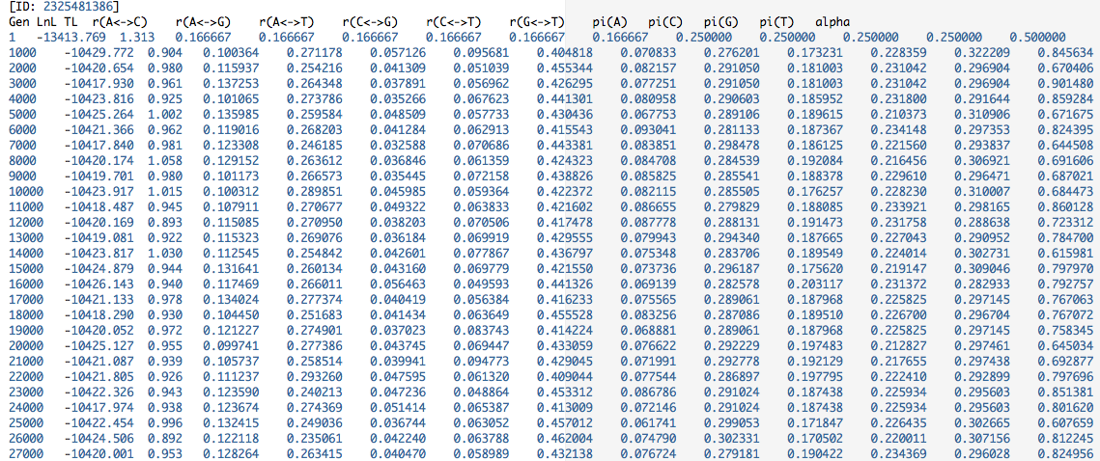
Approximating the Joint Posterior Probability Density using MCMC
Samples from the MCMC simulation approximate the joint posterior
Each row in our log file—with values of all model parameters—is a sample from the joint posterior probability density.

Slide 175
Approximating the Joint Posterior Probability Density using MCMC
Samples from the MCMC simulation approximate the joint posterior
Each row in our log file—with values of all model parameters—is a sample from the joint posterior probability density.

Slide 176
Approximating the Joint Posterior Probability Density using MCMC
Samples from the MCMC simulation approximate the joint posterior
Each row in our log file—with values of all model parameters—is a sample from the joint posterior probability density.

Slide 177
Approximating the Joint Posterior Probability Density using MCMC
Samples from the MCMC simulation approximate the joint posterior
Each column in our log file—with values for a single model parameter—is a sample from the marginal posterior probability density.

Slide 178
Approximating the Joint Posterior Probability Density using MCMC
Samples from the MCMC simulation approximate the joint posterior
We can query the joint distribution marginally with respect to any parameter.

Slide 179
Approximating the Joint Posterior Probability Density using MCMC
Samples from the MCMC simulation approximate the joint posterior
We can do this by simply constructed a histogram for any column in the file this provides an estimate of its marginal posterior probability density

Slide 180
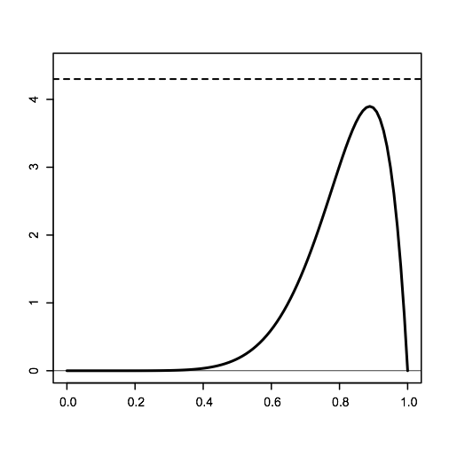
Approximating the Joint Posterior Probability Density using MCMC
Samples from the MCMC simulation approximate the joint posterior
We can do this by simply constructed a histogram for any column in the file this provides an estimate of its marginal posterior probability density

Slide 181
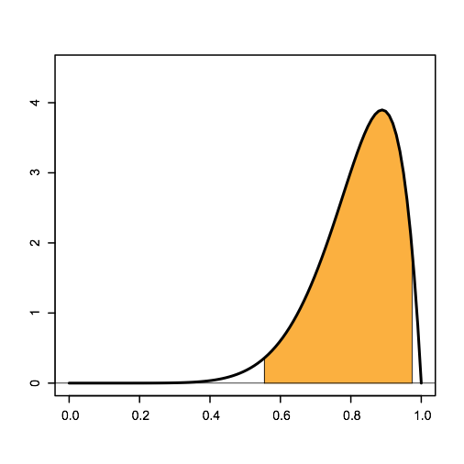
Approximating the Joint Posterior Probability Density using MCMC
Samples from the MCMC simulation approximate the joint posterior
We can easily summarize aspects of the marginal posterior probability density: e.g., to summarize the 95% credible interval.

Slide 182

Approximating the Joint Posterior Probability Density using MCMC
Samples from the MCMC simulation approximate the joint posterior
We can easily summarize aspects of the marginal posterior probability density: e.g., or the probability within some arbitrary interval of interest (0.6–0.8).

Slide 183
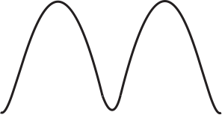
Approximating the Joint Posterior Probability Density using MCMC
Samples from the MCMC simulation approximate the joint posterior
We can easily summarize aspects of the marginal posterior probability density: e.g., or we can summarize the highest posterior density (HPD) interval.
0
1
2
3
4
0.0
0.2
0.4
0.6
0.8
1.0

Slide 184
Approximating the Joint Posterior Probability Density using MCMC
Samples from the MCMC simulation approximate the joint posterior
We can easily summarize aspects of the marginal posterior probability density: e.g., or we can summarize the highest posterior density (HPD) interval.
0
1
2
3
4
0.0
0.2
0.4
0.6
0.8
1.0

Slide 185
Approximating the Joint Posterior Probability Density using MCMC
Samples from the MCMC simulation approximate the joint posterior
We can easily summarize aspects of the marginal posterior probability density: e.g., or we can summarize the highest posterior density (HPD) interval.
0
1
2
3
4
0.0
0.2
0.4
0.6
0.8
1.0

Slide 186
Approximating the Joint Posterior Probability Density using MCMC
Samples from the MCMC simulation approximate the joint posterior
We can easily summarize aspects of the marginal posterior probability density: e.g., or we can summarize the highest posterior density (HPD) interval.
0
1
2
3
4
0.0
0.2
0.4
0.6
0.8
1.0

Slide 187
Outline
I. Bayesian inference, redux
The anatomy and meaning of Bayes theorem
II. Numerical algorithms for Bayesian inference
Markov-chain Monte Carlo (MCMC)
Metropolis-Hastings algorithm
Metropolis-Coupled algorithm
Summarizing posterior samples
III. Diagnosing MCMC performance
Motivation and overview of the basics
IV. MCMC Diagnostics
General strategies:
diagnostics based on single chains
diagnostics based on the prior
diagnostics based on multiple, replicate chains

Slide 188
Outline
I. Bayesian inference, redux
The anatomy and meaning of Bayes theorem
II. Numerical algorithms for Bayesian inference
Markov-chain Monte Carlo (MCMC)
Metropolis-Hastings algorithm
Metropolis-Coupled algorithm
Summarizing posterior samples
III. Diagnosing MCMC performance
Motivation and overview of the basics
IV. MCMC Diagnostics
General strategies:
diagnostics based on single chains
diagnostics based on the prior
diagnostics based on multiple, replicate chains

Slide 189
Approximating the Joint Posterior Probability Density using MCMC
MCMC in theory and practice
MCMC in theory...
an appropriately constructed and adequately run chain is guaranteed to provide an arbitrarily precise description of the joint stationary density

Slide 190
Approximating the Joint Posterior Probability Density using MCMC
MCMC in theory and practice
MCMC in theory...
an appropriately constructed and adequately run chain is guaranteed to provide an arbitrarily precise description of the joint stationary density
MCMC in practice...
although a given sampler may work well in most cases, all samplers will fail in some cases, and is not guaranteed to work for any particular case

Slide 191
Approximating the Joint Posterior Probability Density using MCMC
MCMC in theory and practice
MCMC in theory...
an appropriately constructed and adequately run chain is guaranteed to provide an arbitrarily precise description of the joint stationary density
MCMC in practice...
although a given sampler may work well in most cases, all samplers will fail in some cases, and is not guaranteed to work for any particular case
Q. When do we know that the MCMC provides an accurate approximation for a given empirical analysis?
NEVER!
A.

Slide 192
Approximating the Joint Posterior Probability Density using MCMC
MCMC performance
It is not sufficient to merely be deeply concerned about MCMC performance... you need to be completely obsessed about it!

Slide 193
Approximating the Joint Posterior Probability Density using MCMC
MCMC performance
It is not sufficient to merely be deeply concerned about MCMC performance... you need to be completely obsessed about it!
for any Bayesian inference based on MCMC

Slide 194
Approximating the Joint Posterior Probability Density using MCMC
MCMC performance
It is not sufficient to merely be deeply concerned about MCMC performance... you need to be completely obsessed about it!
for any Bayesian inference based on MCMC
particularly for complex models/inference problems
WE
ARE
HERE
WE
SHOULD
BE HERE
I’LL
BE HERE
careless
careful
paranoid

Slide 195
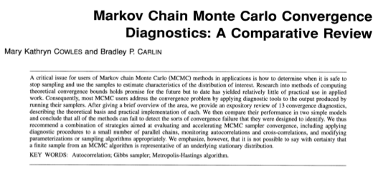
Approximating the Joint Posterior Probability Density using MCMC
MCMC performance and OCD
It is not sufficient to merely be deeply concerned about MCMC performance...
you need to be completely obsessed about it!
for any Bayesian inference based on MCMC
particularly for complex models/inference problems
WE
ARE
HERE
WE
SHOULD
BE HERE
J. Am. Stat. Soc. (1996)

Slide 196
Approximating the Joint Posterior Probability Density using MCMC
MCMC performance and OCD
It is not sufficient to merely be deeply concerned about MCMC performance...
you need to be completely obsessed about it!
for any Bayesian inference based on MCMC
particularly for complex models/inference problems
WE
ARE
HERE
WE
SHOULD
BE HERE
…under simulation, all MCMC diagnostics may fail to detect the exact problems that they were specifically designed to identify…
…therefore, it is critical to use a combination of tools to detect MCMC failure
J. Am. Stat. Soc. (1996)

Slide 197
Outline
I. Bayesian inference, redux
The anatomy and meaning of Bayes theorem
II. Numerical algorithms for Bayesian inference
Markov-chain Monte Carlo (MCMC)
Metropolis-Hastings algorithm
Metropolis-Coupled algorithm
Summarizing posterior samples
III. Diagnosing MCMC performance
Motivation and overview of the basics
IV. MCMC Diagnostics
General strategies:
diagnostics based on single chains
diagnostics based on the prior
diagnostics based on multiple, replicate chains

Slide 198
Outline
I. Bayesian inference, redux
The anatomy and meaning of Bayes theorem
II. Numerical algorithms for Bayesian inference
Markov-chain Monte Carlo (MCMC)
Metropolis-Hastings algorithm
Metropolis-Coupled algorithm
Summarizing posterior samples
III. Diagnosing MCMC performance
Motivation and overview of the basics
IV. MCMC Diagnostics
General strategies:
diagnostics based on single chains
diagnostics based on the prior
diagnostics based on multiple, replicate chains

Slide 199
Assessing MCMC Performance: Three Main Issues
1. Convergence
Has the chain (robot) successfully targeted the stationary distribution?

Slide 200
Assessing MCMC Performance: Three Main Issues
1. Convergence
Has the chain (robot) successfully targeted the stationary distribution?
2. Mixing
Is the chain (robot) efficiently integrating over the joint posterior probability?

Slide 201
Assessing MCMC Performance: Three Main Issues
1. Convergence
Has the chain (robot) successfully targeted the stationary distribution?
2. Mixing
Is the chain (robot) efficiently integrating over the joint posterior probability?
3. Sampling intensity
Have we collected enough samples to adequately describe the posterior probability distribution?

Slide 202
Assessing MCMC Performance: Based on Single Chains
1. Convergence diagnostics
Time-series plots of parameter estimates
Continuous parameters (e.g., substitution rates)
some parameters are more reliable than others
steps may occur!

Slide 203



Assessing MCMC Performance: Based on Single Chains
Example: Tracer plots of tree-length at two stages of a single MrBayes run
all looks good…
until it doesn't
fast*
slow*
lnL
base freq.
sub. rates
ASRV
TL
topology
*somewhat data-set dependent

Slide 204
Assessing MCMC Performance: Based on Single Chains
1. Convergence diagnostics
Time-series plots of parameter estimates
Continuous parameters (e.g., substitution rates)
some parameters are more reliable than others
steps may occur!
Discrete parameters (e.g., bi-partitions)
some parameters are more reliable than others
steps may occur!

Slide 205


Assessing MCMC Performance: Based on Single Chains
Example: AWTY plots of cumulative bi-partition frequency of 5 nodes
bad convergence
better convergence
Nylander et al. (2008)

Slide 206
Assessing MCMC Performance: Based on Single Chains
1. Convergence diagnostics
Time-series plots of parameter estimates
Geweke diagnostic (coda, BOA)
Continuous or discrete parameters
A test for equality of the means of the first and last part of a Markov chain (by default the first 10% and the last 50%)
Geweke (1992)

Slide 207
Assessing MCMC Performance: Based on Single Chains
1. Convergence diagnostics
Time-series plots of parameter estimates
Geweke diagnostic (coda, BOA)
Continuous or discrete parameters
A test for equality of the means of the first and last part of a Markov chain (by default the first 10% and the last 50%)
If the samples are drawn from the stationary distribution, the two means should equal and Geweke’s statistic has an asymptotically standard normal distribution
Geweke (1992)

Slide 208
Assessing MCMC Performance: Based on Single Chains
1. Convergence diagnostics
Time-series plots of parameter estimates
Geweke diagnostic (coda, BOA)
Heidelberg-Welch diagnostic (coda, BOA)
Continuous or discrete parameters
uses the Cramer-von Mises statistic to test the null hypothesis that the sampled values come from a stationary distribution
Heidelberg & Welch (1983)

Slide 209
Assessing MCMC Performance: Based on Single Chains
1. Convergence diagnostics
Time-series plots of parameter estimates
Geweke diagnostic (coda, BOA)
Heidelberg-Welch diagnostic (coda, BOA)
Continuous or discrete parameters
uses the Cramer-von Mises statistic to test the null hypothesis that the sampled values come from a stationary distribution
This test is successively applied, first to the whole chain, then after discarding the first 10%, 20%, … of the samples until either the null hypothesis is accepted, or 50% of the chain has been discarded
Heidelberg & Welch (1983)

Slide 210
Assessing MCMC Performance: Based on Single Chains
1. Convergence diagnostics
Time-series plots of parameter estimates
Geweke diagnostic (coda, BOA)
Heidelberg-Welch diagnostic (coda, BOA)
Continuous or discrete parameters
uses the Cramer-von Mises statistic to test the null hypothesis that the sampled values come from a stationary distribution
This test is successively applied, first to the whole chain, then after discarding the first 10%, 20%, … of the samples until either the null hypothesis is accepted, or 50% of the chain has been discarded
The latter outcome constitutes “failure” of the test and indicates that a longer run is needed
Heidelberg & Welch (1983)

Slide 211
Assessing MCMC Performance: Based on Single Chains
1. Convergence diagnostics
Time-series plots of parameter estimates
Geweke diagnostic (coda, BOA)
Heidelberg-Welch diagnostic (coda, BOA)
Continuous or discrete parameters
uses the Cramer-von Mises statistic to test the null hypothesis that the sampled values come from a stationary distribution
This test is successively applied, first to the whole chain, then after discarding the first 10%, 20%, … of the samples until either the null hypothesis is accepted, or 50% of the chain has been discarded
The latter outcome constitutes “failure” of the test and indicates that a longer run is needed
Otherwise, the number of iterations to keep and the number to discard (burn-in) are reported
Heidelberg & Welch (1983)

Slide 212
Assessing MCMC Performance: Based on Single Chains
1. Convergence diagnostics
Time-series plots of parameter estimates
Geweke diagnostic (coda, BOA)
Heidelberg-Welch diagnostic (coda, BOA)
(many others)

Slide 213
Assessing MCMC Performance: Based on Single Chains
2. Mixing diagnostics
Form of the time-series plots of parameter estimates
Continuous parameters (e.g., substitution rates)
warm and fuzzy caterpillars

Slide 214


Assessing MCMC Performance: Based on Single Chains
Example: Tracer plots of relative-rate multipliers from two MrBayes runs
bad mixing
better mixing

Slide 215


Assessing MCMC Performance: Based on Single Chains
Example: Tracer plots of relative-rate multipliers from two MrBayes runs
bad mixing
better mixing

Slide 216
Assessing MCMC Performance: Based on Single Chains
2. Mixing diagnostics
Form of the time-series plots of parameter estimates
Continuous parameters (e.g., substitution rates)
warm and fuzzy caterpillars
Acceptance rates of parameter updates
Continuous and discrete parameters (MrBayes, BEAST)
rates should ideally fall in the ~20–70% range

Slide 217
Assessing MCMC Performance: Based on Single Chains
Example: Tracer plots of relative-rate multipliers from two MrBayes runs
bad mixing
better mixing
Acceptance rates for the moves in the "cold" chain of run 1:
With prob. Chain accepted changes to
13.61 % param. 1 (revmat) with Dirichlet proposal
.
.
.
0.04 % param. 34 (rate multiplier) Dirichlet proposal
6.59 % param. 35 (topology and branch lengths) TBR
14.06 % param. 35 (topology and branch lengths) LOCAL
Acceptance rates for the moves in the "cold" chain of run 1:
With prob. Chain accepted changes to
33.30 % param. 1 (revmat) with Dirichlet proposal
.
.
.
19.13 % param. 34 (rate multiplier) Dirichlet proposal
17.40 % param. 35 (topology and branch lengths) TBR
29.76 % param. 35 (topology and branch lengths) LOCAL

Slide 218
Assessing MCMC Performance: Based on Single Chains
2. Mixing diagnostics
Form of the time-series plots of parameter estimates
Continuous parameters (e.g., substitution rates)
warm and fuzzy caterpillars
Acceptance rates of parameter updates
Continuous and discrete parameters (MrBayes, BEAST)
rates should ideally fall in the ~20–70% range
acceptance rates can be controlled by varying the scale of the tuning parameters for the relevant proposal mechanisms

Slide 219
Assessing MCMC Performance: Based on Single Chains
2. Mixing diagnostics
Form of the time-series plots of parameter estimates
Continuous parameters (e.g., substitution rates)
warm and fuzzy caterpillars
Acceptance rates of parameter updates
Continuous and discrete parameters (MrBayes, BEAST)
rates should ideally fall in the ~20–70% range
acceptance rates can be controlled by varying the scale of the tuning parameters for the relevant proposal mechanisms
to increase acceptance rates, decrease scale of tuning parameter (and vice versa)
parameter
prior distribution
tuning parameter
proposal weights
pi ~ dnDirichlet(pi_prior)
#moves for base frequencies
moves[++mi] = mvSimplexElementScale(pi, alpha=10.0, tune=true, weight=1.0)

Slide 220
Assessing MCMC Performance: Based on Single Chains
2. Mixing diagnostics
Form of the time-series plots of parameter estimates
Continuous parameters (e.g., substitution rates)
warm and fuzzy caterpillars
Acceptance rates of parameter updates
Continuous and discrete parameters (MrBayes, BEAST)
rates should ideally fall in the ~20–70% range
Form of the marginal posterior probability densities
Continuous parameters (e.g., substitution rates)
beware of porcupine roadkill!

Slide 221


Assessing MCMC Performance: Based on Single Chains
Example: Tracer plots of relative-rate multipliers from two MrBayes runs
bad mixing
better mixing
Acceptance rates for the moves in the "cold" chain of run 1:
With prob. Chain accepted changes to
13.61 % param. 1 (revmat) with Dirichlet proposal
.
.
.
0.04 % param. 34 (rate multiplier) Dirichlet proposal
6.59 % param. 35 (topology and branch lengths) TBR
14.06 % param. 35 (topology and branch lengths) LOCAL
Acceptance rates for the moves in the "cold" chain of run 1:
With prob. Chain accepted changes to
33.30 % param. 1 (revmat) with Dirichlet proposal
.
.
.
19.13 % param. 34 (rate multiplier) Dirichlet proposal
17.40 % param. 35 (topology and branch lengths) TBR
29.76 % param. 35 (topology and branch lengths) LOCAL

Slide 222
Assessing MCMC Performance: Based on Single Chains
Example: Tracer plots of relative-rate multipliers from two MrBayes runs
bad mixing
better mixing
Acceptance rates for the moves in the "cold" chain of run 1:
With prob. Chain accepted changes to
13.61 % param. 1 (revmat) with Dirichlet proposal
.
.
.
0.04 % param. 34 (rate multiplier) Dirichlet proposal
6.59 % param. 35 (topology and branch lengths) TBR
14.06 % param. 35 (topology and branch lengths) LOCAL
Acceptance rates for the moves in the "cold" chain of run 1:
With prob. Chain accepted changes to
33.30 % param. 1 (revmat) with Dirichlet proposal
.
.
.
19.13 % param. 34 (rate multiplier) Dirichlet proposal
17.40 % param. 35 (topology and branch lengths) TBR
29.76 % param. 35 (topology and branch lengths) LOCAL

Slide 223
Assessing MCMC Performance: Based on Single Chains
2. Mixing diagnostics
Form of the time-series plots of parameter estimates
Continuous parameters (e.g., substitution rates)
warm and fuzzy caterpillars
Acceptance rates of parameter updates
Continuous and discrete parameters (MrBayes, BEAST)
rates should ideally fall in the ~20–70% range
Form of the marginal posterior probability densities
Continuous parameters (e.g., substitution rates)
beware of porcupine roadkill!

Slide 224
Assessing MCMC Performance: Based on Single Chains
2. Mixing diagnostics
Form of the time-series plots of parameter estimates
Continuous parameters (e.g., substitution rates)
warm and fuzzy caterpillars
Acceptance rates of parameter updates
qualitative diagnostics
Continuous and discrete parameters (MrBayes, BEAST)
rates should ideally fall in the ~20–70% range
Form of the marginal posterior probability densities
Continuous parameters (e.g., substitution rates)
beware of porcupine roadkill!

Slide 225
Assessing MCMC Performance: Based on Single Chains
2. Mixing diagnostics
Form of the time-series plots of parameter estimates
Continuous parameters (e.g., substitution rates)
warm and fuzzy caterpillars
Acceptance rates of parameter updates
qualitative diagnostics
Continuous and discrete parameters (MrBayes, BEAST)
rates should ideally fall in the ~20–70% range
Form of the marginal posterior probability densities
Continuous parameters (e.g., substitution rates)
beware of porcupine roadkill!
quantitative diagnostics
Autocorrelation time (ACT) of parameter samples
Effective sample size (ACT) of parameter samples

Slide 226

Assessing MCMC Performance: Based on Single Chains
2. Mixing diagnostics
Autocorrelation time (ACT) of parameter samples
The lag (number of cycles) it takes for autocorrelation in parameter values to break down.
The lag k autocorrelation is the correlation every draw and its k^{th} lag:
We would expect the k^{th} lag autocorrelation to be smaller as k increases (our 1st and 100th draws should be less correlated than our 1st and 2nd draws).
If autocorrelation is still relatively high for higher values of k, this indicates high degree of correlation between our draws and slow mixing.

Slide 227

Assessing MCMC Performance: Based on Single Chains
Example: Autocorrelation time (ACT) of parameter samples
efficient mixing
slow mixing

Slide 228
Assessing MCMC Performance: Based on Single Chains
2. Mixing diagnostics
Effective Sample Size (ESS) diagnostic
Continuous or discrete parameters
number of samples/autocorrelation time (ACT)

Slide 229

Assessing MCMC Performance: Based on Single Chains
Example: ESS values for relative-rate multipliers from two RevBayes runs
poor mixing

Slide 230
Assessing MCMC Performance: Based on Single Chains
3. Sample-size diagnostics
Form of the marginal posterior probability densities
Continuous parameters
brother of porcupine roadkill
ensure SAE compliance!

Slide 231


Assessing MCMC Performance: Based on Single Chains
Example: Parameter estimates for mean-rate multipliers from BEAST runs
poor sampling
better sampling
1M cycles
5M cycles
inadequate chain length/poor mixing

Slide 232

Assessing MCMC Performance: Based on Single Chains
Example: Parameter estimates for mean-rate multipliers from BEAST runs
poor sampling
better sampling
1M cycles
10M cycles
inadequate chain length/poor mixing

Slide 233
Assessing MCMC Performance: Based on Single Chains
Example: Parameter estimates for mean-rate multipliers from BEAST runs
poor sampling
better sampling
1M cycles
40M cycles
inadequate chain length/poor mixing

Slide 234

Assessing MCMC Performance: Based on Single Chains
Example: Parameter estimates for mean-rate multipliers from BEAST runs
poor sampling
better sampling
1M cycles
40M cycles
inadequate chain length/poor mixing
all continuous parameters should be SAE
KDE SAE does not count (use histogram render)

Slide 235


Assessing MCMC Performance:
Diagnostics Based on Single Runs
MCMC pathologies
Parameter interaction between I+G mixture for among-site rate variation
a relatively large p a large value of alpha
a relatively small p a small value of alpha
alpha
p

Slide 236

Assessing MCMC Performance:
Diagnostics Based on Single Runs
MCMC pathologies
Parameter interaction between I+G mixture for among-site rate variation
a relatively large p a large value of alpha
a relatively small p a small value of alpha
alpha
p

Slide 237

Assessing MCMC Performance:
Diagnostics Based on Single Runs
MCMC pathologies
Parameter interaction between I+G mixture for among-site rate variation
a relatively large p a large value of alpha
a relatively small p a small value of alpha
alpha
p
multi-modal marginal densities indicate parameter interaction/non-identifiability
use with additional discrete rate categories

Slide 238

Assessing MCMC Performance:
Diagnostics Based on Single Runs
MCMC pathologies
Can identify parameter interaction by plotting joint distribution
p
alpha

Slide 239
Outline
I. Bayesian inference, redux
The anatomy and meaning of Bayes theorem
II. Numerical algorithms for Bayesian inference
Markov-chain Monte Carlo (MCMC)
Metropolis-Hastings algorithm
Metropolis-Coupled algorithm
Summarizing posterior samples
III. Diagnosing MCMC performance
Motivation and overview of the basics
IV. MCMC Diagnostics
General strategies:
diagnostics based on single chains
diagnostics based on the prior
diagnostics based on multiple, replicate chains

Slide 240
Outline
I. Bayesian inference, redux
The anatomy and meaning of Bayes theorem
II. Numerical algorithms for Bayesian inference
Markov-chain Monte Carlo (MCMC)
Metropolis-Hastings algorithm
Metropolis-Coupled algorithm
Summarizing posterior samples
III. Diagnosing MCMC performance
Motivation and overview of the basics
IV. MCMC Diagnostics
General strategies:
diagnostics based on single chains
diagnostics based on the prior
diagnostics based on multiple, replicate chains

Slide 241
Assessing MCMC Performance: Diagnostics Based on the Prior
Estimating under the prior...
Marginal posterior densities for parameters are updated versions of the corresponding prior probability densities: they are updated by the information in the data via the likelihood function.
likelihood function
prior probability
posterior probability
marginal likelihood

Slide 242
Assessing MCMC Performance: Diagnostics Based on the Prior
Estimating under the prior...
Marginal posterior densities for parameters are updated versions of the corresponding prior probability densities: they are updated by the information in the data via the likelihood function.
We can compare the marginal prior densities to their posterior counterparts to help identify weak parameters.

Slide 243
Assessing MCMC Performance: Diagnostics Based on the Prior
Estimating under the prior...
Marginal posterior densities for parameters are updated versions of the corresponding prior probability densities: they are updated by the information in the data via the likelihood function.
We can compare the marginal prior densities to their posterior counterparts to help identify weak parameters.
MCMC can be run to target the joint prior probability density either by estimating with no data or by forcing the likelihood function return 1.
likelihood ratio
prior ratio
proposal ratio

Slide 244


Assessing MCMC Performance: Diagnostics Based on the Prior
Does the marginal prior resemble the marginal posterior?
weak parameter
strong parameter

Slide 245
Assessing MCMC Performance: Diagnostics Based on the Prior
Does the marginal prior resemble the marginal posterior?
weak parameter
strong parameter
Strong departure of marginal prior and posterior is always good news

Slide 246
Assessing MCMC Performance: Diagnostics Based on the Prior
Does the marginal prior resemble the marginal posterior?
weak parameter
strong parameter
Strong departure of marginal prior and posterior is always good news
Similarity between the marginal prior and posterior may indicate:
good news (you chose a great prior)
bad news (no information in your data to estimate the parameter)

Slide 247
Outline
I. Bayesian inference, redux
The anatomy and meaning of Bayes theorem
II. Numerical algorithms for Bayesian inference
Markov-chain Monte Carlo (MCMC)
Metropolis-Hastings algorithm
Metropolis-Coupled algorithm
Summarizing posterior samples
III. Diagnosing MCMC performance
Motivation and overview of the basics
IV. MCMC Diagnostics
General strategies:
diagnostics based on single chains
diagnostics based on the prior
diagnostics based on multiple, replicate chains

Slide 248
Outline
I. Bayesian inference, redux
The anatomy and meaning of Bayes theorem
II. Numerical algorithms for Bayesian inference
Markov-chain Monte Carlo (MCMC)
Metropolis-Hastings algorithm
Metropolis-Coupled algorithm
Summarizing posterior samples
III. Diagnosing MCMC performance
Motivation and overview of the basics
IV. MCMC Diagnostics
General strategies:
diagnostics based on single chains
diagnostics based on the prior
diagnostics based on multiple, replicate chains

Slide 249
Assessing MCMC Performance: Diagnostics Based on Multiple Runs
Compare estimates from multiple independent chains
Form of the marginal posterior densities for all parameters
Continuous parameters

Slide 250


Assessing MCMC Performance: Diagnostics Based on Multiple Runs
Example: Tracer plots of marginal densities from multiple RevBayes runs
bad convergence
better convergence
run 1
run 1
run 2
run 2
run 3
run 3
run 4
run 4
run 5
run 5
run 6
run 6
Parameter estimates from replicate independent MCMC analyses should be effectively identical.

Slide 251
Assessing MCMC Performance: Diagnostics Based on Multiple Runs
Compare estimates from multiple independent chains
Form of the marginal posterior densities for all parameters
Continuous parameters
PSRF (Gelman–Rubin) diagnostic
Continuous and discrete parameters
1. Run m ≥ 2 chains of length 2c from overdispersed starting values.
2. Discard the first n draws of each chain.
3. Calculate the within-chain and between-chain variance.
4. Calculate the estimated variance of the parameter as a weighted sum of the within-chain and between-chain variance.
5. Calculate the PSRF.

Slide 252
Assessing MCMC Performance: Diagnostics Based on Multiple Runs
Example: PSRF values for relative-rate multipliers from two MrBayes runs
95% Cred. Interval
----------------------
Parameter Mean Variance Lower Upper Median PSRF *
-------------------------------------------------------------------------------------------
TL{all} 4.921609 2.998138 2.836000 7.295000 5.056000 9.084
kappa{4,5} 3.095696 0.054125 2.667623 3.587024 3.085271 1.000
alpha{5} 1.006544 0.087721 0.606472 1.738482 0.950093 1.000
pinvar{1} 0.307396 0.009357 0.095913 0.471070 0.316173 1.000
m{1} 0.264226 0.009315 0.146502 0.421870 0.244468 5.507
m{2} 0.040919 0.000227 0.022205 0.065884 0.037425 5.279
m{3} 2.721453 7.157157 0.039001 5.544253 5.030560 69.564
m{4} 2.125810 3.568002 0.199137 4.044249 3.917338 150.012
m{5} 0.188768 0.004373 0.109303 0.295129 0.170624 5.749
-------------------------------------------------------------------------------------------
bad convergence
better convergence
95% Cred. Interval
----------------------
Parameter Mean Variance Lower Upper Median PSRF *
-------------------------------------------------------------------------------------------
TL{all} 0.073893 0.000034 0.063000 0.086000 0.074000 1.000
kappa{2,3} 3.236308 0.366904 2.199024 4.587719 3.190195 1.000
m{1} 1.285838 0.028345 0.980634 1.630387 1.278161 1.000
m{2} 1.423906 0.015507 1.182596 1.664627 1.423610 1.000
m{3} 0.589346 0.005341 0.453175 0.736459 0.587617 1.001
-------------------------------------------------------------------------------------------

Slide 253
Assessing MCMC Performance: Diagnostics Based on Multiple Runs
Compare estimates from multiple independent chains
Form of the marginal posterior densities for all parameters
Continuous parameters
PSRF (Gelman–Rubin) diagnostic
Continuous and discrete parameters
Comparing independent samples of trees
ASDSF: similarity of trees sampled by paired, independent chains

Slide 254

Assessing MCMC Performance: Diagnostics Based on Multiple Runs
Example: ASDSF
The overall similarity of the trees sampled by two independent, simultaneous MCMC analyses
ASDSF
0.01
time
Terminate chain when ASDSF < 0.01

Slide 255
Assessing MCMC Performance: Diagnostics Based on Multiple Runs
Compare estimates from multiple independent chains
Form of the marginal posterior densities for all parameters
Continuous parameters
PSRF (Gelman–Rubin) diagnostic
Continuous and discrete parameters
Comparing independent samples of trees
ASDSF: similarity of trees sampled by paired, independent chains
split frequencies & presence/absence plots

Slide 256


Assessing MCMC Performance: Diagnostics Based on Multiple Runs
Example: split frequencies & presence/absence in AWTY
bad convergence
better convergence
Track the frequency of a single node in trees sampled by two independent chains

Slide 257
Assessing MCMC Performance: Diagnostics Based on Multiple Runs
Compare estimates from multiple independent chains
Form of the marginal posterior densities for all parameters
Continuous parameters
PSRF (Gelman–Rubin) diagnostic
Continuous and discrete parameters
Comparing independent samples of trees
ASDSF: similarity of trees sampled by paired, independent chains
split frequencies & presence/absence plots
Compare-tree plots

Slide 258


Assessing MCMC Performance: Diagnostics Based on Multiple Runs
Example: ‘comparetrees’ plot of trees sampled by two MrBayes runs
bad convergence
better convergence
1
1
0.5
0.5
run 2 nodal probabilities
run 2 nodal probabilities
0
0
0
0.5
1
0
0.5
1
run 1 nodal probabilities
run 1 nodal probabilities
Compare estimates of node probabilities estimated by two independent chains

Slide 259

Summary: Some General Strategies for Assessing MCMC Performance
“You can never be absolutely certain that the MCMC is reliable, you can only identify when something has gone wrong.” Andrew Gelman (hero)

Slide 260
Summary: Some General Strategies for Assessing MCMC Performance
1. When do you need to assess MCMC performance?
ALWAYS
2. When should you assess the performance of individual runs?
ALWAYS
3. Which diagnostics should you use to assess individual runs?
ALL that are relevant for the models/parameters you are estimating under
4. When is a single run sufficient to assess MCMC performance?
NEVER
5. When should you estimate under the prior?
WHENEVER POSSIBLE (and be wary of programs where it is not possible)

Slide 261
Summary: Some General Strategies for Assessing MCMC Performance
6. When should you use Metropolis-Coupling?
Whenever you cannot be certain that standard MCMC is adequate
i.e., ALWAYS (and be wary of programs where it is not possible)
7. When should you perform multiple independent MCMC runs?
ALWAYS (and be wary of pseudo-independence)
8. Which diagnostics should you use to assess multiple runs?
ALL that are relevant for the models/parameters you are estimating under
9. How many independent MCMC runs are sufficient?
AS MANY AS POSSIBLE (i.e., as many as you think your data/problem deserve)
10. How long should you run each MCMC analysis?
AS LONG AS POSSIBLE (i.e., as long as you think your data/problem deserve)

Slide 262
Statistical Estimation of Phylogeny: An Outline
Inference Method
Data
Model
Parameter
Estimates
sequence
alignment
tree with
branch lengths
maximum likelihood
phylogeny & other model parameters
substitution
model
Bayesian inference

Slide 263
Statistical Estimation of Phylogeny: An Outline
Inference Method
Data
Models
Parameter
Estimates
sequence
alignment
tree with
branch lengths
maximum likelihood
phylogeny & other model parameters
substitution
model
Bayesian inference
Next time!!

